Slide 1

Daniel Institute, MA Sacred Ministry
HISTORY OF
REVIVALS
By Charles Owiredu, PhD (Durham)

Slide 2


REVIVAL SONG 1
There’s A Sweet Spirit

Slide 3
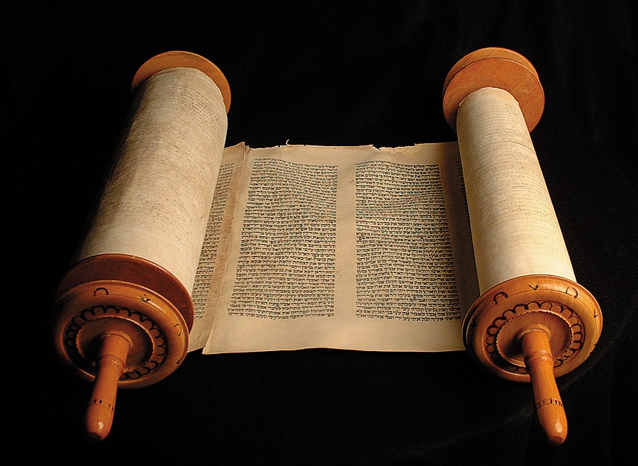
LECTURE
8
The East African Revival

Slide 4

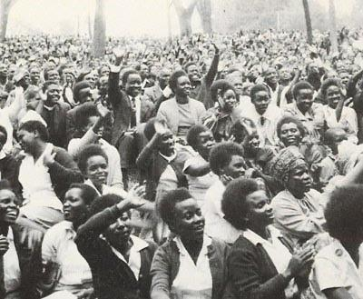
The 1936 East African Revival

