Slide 1

Daniel Institute, MA Sacred Ministry
HISTORY OF
REVIVALS
By Charles Owiredu, PhD (Durham)

Slide 2


REVIVAL SONG 1
There’s A Sweet Spirit

Slide 3
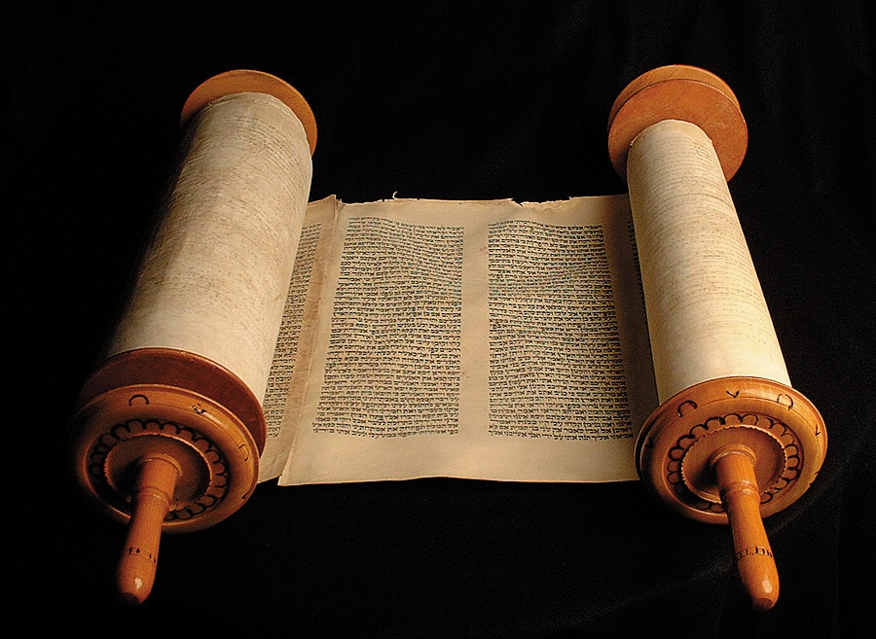
LECTURE
5
20th Century Revivals

Slide 4

20th Century Revivals
A: The most recent Great Awakening
(1904 onwards) had its roots in the holiness movement which had developed in the late 19th century. The Pentecostal revival movement began, out of a passion for more power and a greater outpouring of the Holy Spirit.

Slide 5
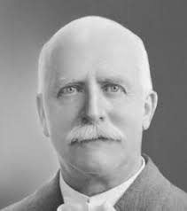
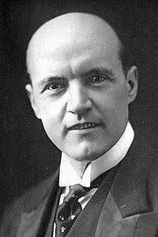
20th Century Revivals
B: In 1902 the American evangelists Reuben Archer Torrey and Charles McCallon Alexander conducted meetings in Melbourne, Australia, resulting in more than 8,000 converts.
R. A. Torrey
C. A. Alexander

Slide 6
20th Century Revivals
C: Torrey and Alexander were
involved in the beginnings of the great Welsh Revival (1904). In 1906 the modern Pentecostal movement was born in Azusa Street, in Los Angeles.

Slide 7
20th Century Revivals
A: The Welsh revival was not an
isolated religious movement but very much a part of Britain's modernization.

Slide 8
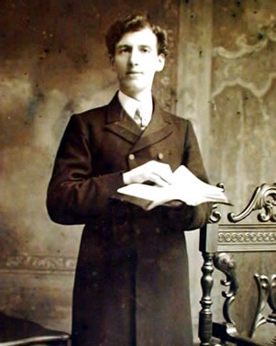
20th Century Revivals
B: The revival began in the fall of 1904 under the leadership of Evans Roberts (1878–1951), a 26-year-old former collier and minister-in-training. The revival lasted less than a year, but in that period 100,000 converts were made.

Slide 9
20th Century Revivals
C: Begun as an effort to kindle
nondenominational, nonsectarian spirituality, the Welsh revival of 1904–05 coincided with the rise of the labor movement, socialism, and a general disaffection with religion among the working class and youths.

Slide 10
20th Century Revivals
The Pyongyang Great Revival (1907-1910) in North Korea started when the Korean church was barely 20 years old. The effect was still strong in 1910.

Slide 11
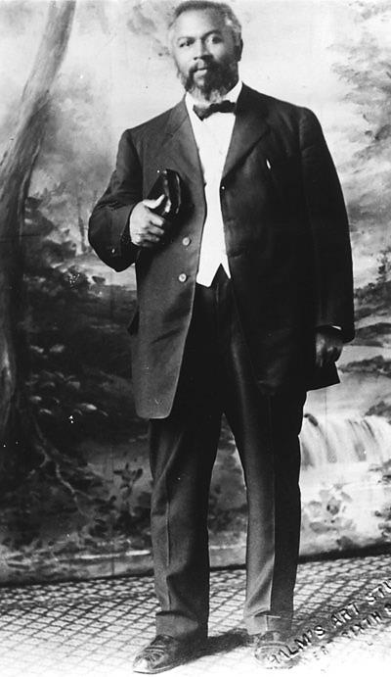
20th Century Revivals
The Azusa Street Revival – Brief Biography of William J. Seymour
In 1905, William J. Seymour, the one-eyed 34-year-old son of freed slaves, was a student of well-known Pentecostal preacher Charles Parham and an interim pastor for a small holiness church in Topeka, Kansas.

Slide 12
20th Century Revivals
The Azusa Street Revival - The Environment
Took place in a discarded lumber and plaster littered, large, barn-like room.
Church services were held on the first floor where the benches were placed in a rectangular pattern. Some of the benches were simply planks put on top of empty nail kegs. There was no elevated platform, as the ceiling was only eight feet high. Initially there was no pulpit. Seymour generally sat behind two empty shoe boxes, one on top of the other. He usually kept his head inside the top one during the meeting, in prayer.

Slide 13
20th Century Revivals
The Azusa Street Revival - Testimonies
A young man says: he was privileged to see the Lord moving signs and wonders and glory manifestations in his church, even when he was very young. And he said that during revival meetings, the fire department was contacted after several people in the neighborhood saw the roof of the church on fire. And he explained that the church roof was not physically on fire, but it was a supernatural fire. And the Holy Spirit was allowing people in the neighborhood to see it.”

Slide 14
20th Century Revivals
The Azusa Street Revival - Testimonies
First-hand accounts were reports of the blind having their sight restored, diseases cured instantly, and immigrants speaking in German, Yiddish, and Spanish all being spoken to in their native language by uneducated black members, who translated the languages into English by "supernatural ability."

Slide 15
20th Century Revivals
The Brownsville Revival
The Brownsville Revival (also known as the Pensacola Outpouring) was a widely reported Christian revival within the Pentecostal movement that began on Father's Day June 18, 1995, at Brownsville Assembly of God in Pensacola, Florida.[1] Characteristics of the Brownsville Revival movement, as with other Christian religious revivals, included acts of repentance by parishioners and a call to holiness, inspired by the manifestation of the Holy Spirit.

Slide 16
20th Century Revivals
The Brownsville Revival
All told, more than 2.5 million people have visited the church's Monday prayer and Tues-through-Saturday evening revival services, where they sang rousing worship music and heard old-fashioned sermons on sin and salvation. After the sermons were over, hundreds of thousands accepted the invitation to leave their seats and rush forward to a large area in front of the stage-like altar.

Slide 17
20th Century Revivals
The Brownsville Revival
In 1993, two years before the revival began, Brownsville's pastor, John Kilpatrick, began directing his congregation to pray for revival. Over the next two years, he talked constantly about bringing revival to the church, even going as far as to threaten to leave the church if it didn't accept the revival.

Slide 18
