Slide 1

HISTORY OF
REVIVALS
By Charles Owiredu, PhD (Durham)

Slide 2
REVIVAL SONG 1
There’s A Sweet Spirit

Slide 3
LECTURE 1
Defining revival, renewal, and awakening

Slide 4
Defining Revival, Renewal, and Awakening
Introduction
The restoration of the presence of God returning to His people in order that His presence lives in their midst. Thus, affecting every part of life in that church in a corporate and collective manner. Some characteristics include:
A new desire for prayer.
A new urgency to respond to the purposes of God, when God descend upon people within and beyond the walls of the church.
Conversions begin to increase.
The fear of the Lord descends upon the area.
A great example of a revival is the Almolonga Revival.

Slide 5

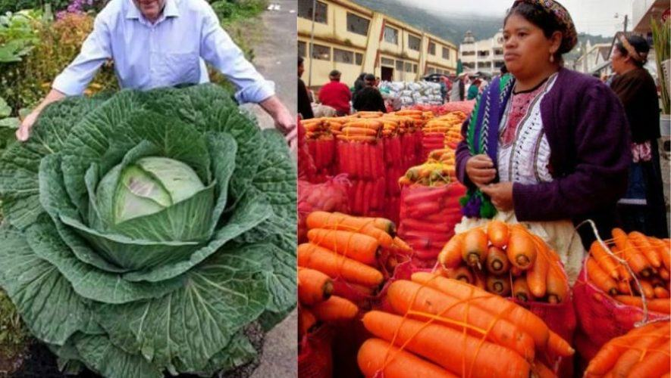
Defining Revival, Renewal, and Awakening
Results of the Almolonga Revival

Slide 6
Defining Revival, Renewal, and Awakening
A. Renewal
Renewal can be defined as a stirring up of God’s people in a given area to the love and purpose of God with fresh awareness of the activity of Holy Spirit and the return to the seeking of God’s power in their lives.

Slide 7
Defining Revival, Renewal, and Awakening
B. Revival
Christian revivalism is increased spiritual interest or renewal in the life of a church congregation or society, with a local, national or global effect. Proponents view revivals as the restoration of the church itself to a vital and fervent relationship with God after a period of moral decline.
This should be distinguished from the use of the term "revival" to refer to an evangelistic meeting or series of meetings.

Slide 8
Defining Revival, Renewal, and Awakening
God's quickening visitation of his people, touching their hearts and deepening his work of grace in their lives." J. I. Packer
Extraordinary season of religious interest." Robert Baird

Slide 9
Defining Revival, Renewal, and Awakening
“it is the sovereign act of God, in which He restores His own backsliding people to repentance, faith and obedience." Stephen Olford
"times of refreshing from the presence of the Lord." (Acts 3:19) J. Edwin Orr
"the awakening or quickening of God's people to their true nature and purpose." Robert Coleman

Slide 10
Defining Revival, Renewal, and Awakening
"the return of the Church from her backslidings, and the conversion of sinners." Charles Finney
"An extraordinary movement of the Holy Spirit producing extraordinary results." Richard Owen Roberts

Slide 11
Defining Revival, Renewal, and Awakening
"A community saturated with God" Duncan Campbell
"The work of the Holy Spirit in restoring the people of God to a more vital spiritual life, witness, and work by prayer and the Word after repentance in crisis for their spiritual decline." Earle Cairns

Slide 12
Defining Revival, Renewal, and Awakening
C. Transformation
This is the result of lasting revival – here we see the effect of revival in social and economic transformation of a community as well as the ecology itself.
(2 Chron. 7:14)

Slide 13
Defining Revival, Renewal, and Awakening
Distinction between revival and awakening
Renewal: When God touches the heart of a single individual
Revival: When God touches a community of faith
Awakening: When the wider society is impacted

Slide 14
Defining Revival, Renewal, and Awakening
Relationship between Revival and Evangelism
1. Revival always produces evangelism.
2. Evangelism, when combined with discipling, sustains revival.

Slide 15
REVIVAL SONG 2
Revive Us Again

