Slide 1

Daniel Institute, MA Sacred Ministry
HISTORY OF
REVIVALS
By Charles Owiredu, PhD (Durham)

Slide 2


REVIVAL SONG 1
There’s A Sweet Spirit

Slide 3
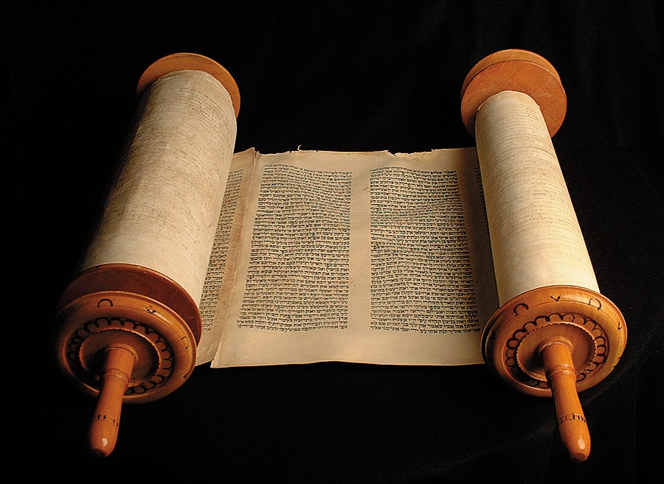
LECTURE
4
19th Century Revivals

Slide 4

19th Century Revivals
The Hungarian Baptist church sprung out of revival with the perceived liberalism of the Hungarian reformed church during the late 1800s. Many thousands of people were baptized in a revival that was led primarily by uneducated laymen, the so-called "peasant prophets".

Slide 5
19th Century Revivals
During the 18th century, England saw a series of Methodist revivalist campaigns that stressed the tenets of faith set forth by John Wesley and that were conducted in accordance with a careful strategy. In addition to stressing the evangelist combination of "Bible, cross, conversion, and activism," the revivalist movement of the 19th century made efforts toward a universal appeal – rich and poor, urban and rural, and men and women. Special efforts were made to attract children and to generate literature to spread the revivalist message.

Slide 6
19th Century Revivals
Early in the 19th century the Scottish minister Thomas Chalmers had an important influence on the evangelical revival movement. Chalmers began life as a moderate in the Church of Scotland and an opponent of evangelicalism. During the winter of 1803–04, he presented a series of lectures that outlined a reconciliation of the apparent incompatibility between the Genesis account of creation and the findings of the developing science of geology. However, by 1810 he had become an evangelical and would eventually lead the Disruption of 1843 that resulted in the formation of the Free Church of Scotland.

Slide 7
19th Century Revivals
In 1833 a group of Anglican clergymen led by John Henry Newman and John Keble began the Oxford Movement. However its objective was to renew the Church of England by reviving certain Roman Catholic doctrines and rituals, thus distancing themselves as far as possible from evangelical enthusiasm.

Slide 8
19th Century Revivals
In the U.S. the Second Great Awakening (1800–30s) was the second great religious revival in United States history and consisted of renewed personal salvation experienced in revival meetings. Major leaders included Asahel Nettleton, James Brainerd Taylor, Charles Grandison Finney, Lyman Beecher, Barton Stone, Alexander Campbell, Peter Cartwright and James B. Finley.

Slide 9
19th Century Revivals
Rev. Charles Finney (1792–1875) was a key leader of the evangelical revival movement in America. From 1821 onwards he conducted revival meetings across many north-eastern states and won many converts. For him, a revival was not a miracle but a change of mindset that was ultimately a matter for the individual's free will. His revival meetings created anxiety in a penitent's mind that one could only save his or her soul by submission to the will of God, as illustrated by Finney's quotations from the Bible. Finney also conducted revival meetings in England, first in 1849 and later to England and Scotland in 1858–59.

Slide 10
19th Century Revivals
North America the Great Awakening began from 1857 onwards in Canada and spread throughout the world including America and Australia. Significant names include Dwight L. Moody, Ira D. Sankey, William Booth and Catherine Booth (founders of the Salvation Army), Charles Spurgeon and James Caughey. Hudson Taylor began the China Inland Mission and Thomas John Barnardo founded his famous orphanages.

Slide 11
19th Century Revivals
In England the Keswick Convention movement began out of the British Holiness movement, encouraging a lifestyle of holiness, unity and prayer.

Slide 12
19th Century Revivals
On 21 September 1857, Jeremiah Lanphier a businessman, began a series of prayer meetings in New York. By the beginning of 1858 the congregation was crowded, often with a majority of businessmen. Newspapers reported that over 6,000 were attending various prayer meetings in New York, and 6,000 in Pittsburgh. Daily prayer meetings were held in Washington, D.C. at 5 different times to accommodate the crowds. Other cities followed the pattern. Soon, a common mid-day sign on business premises read, "We will re-open at the close of the prayer meeting". By May, 50,000 of New York's 800,000 people were new converts.

Slide 13
19th Century Revivals
Finney wrote of this revival, "This winter of 1857–58 will be remembered as the time when a great revival prevailed. It swept across the land with such power that at the time it was estimated that not less than 50,000 conversions occurred weekly."

Slide 14
19th Century Revivals
In 1857, four young Irishmen began a weekly prayer meeting in the village of Connor near Ballymena. This meeting is generally regarded as the origin of the 1859 Ulster Revival that swept through most of the towns and villages throughout Ulster and in due course brought 100,000 converts into the churches. It was also ignited by a young preacher, Henry Grattan Guinness who drew thousands at a time to hear his preaching.

Slide 15
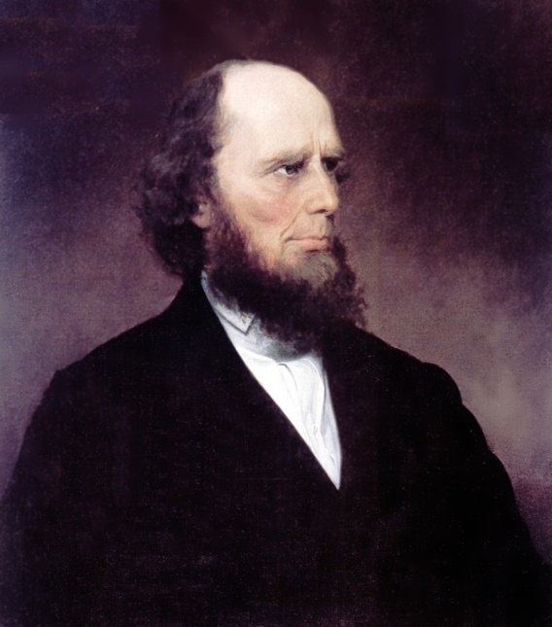
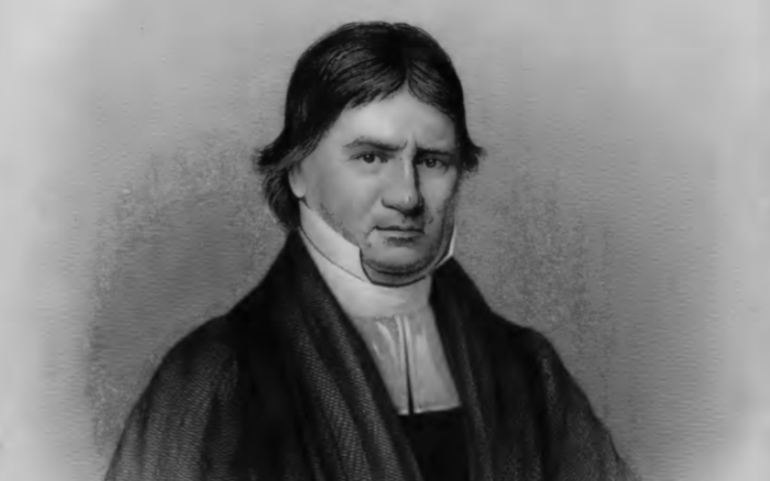
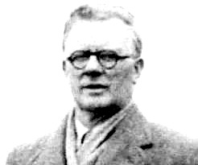
Charles Finney
Daniel Nash
Duncan Campbell

Slide 16
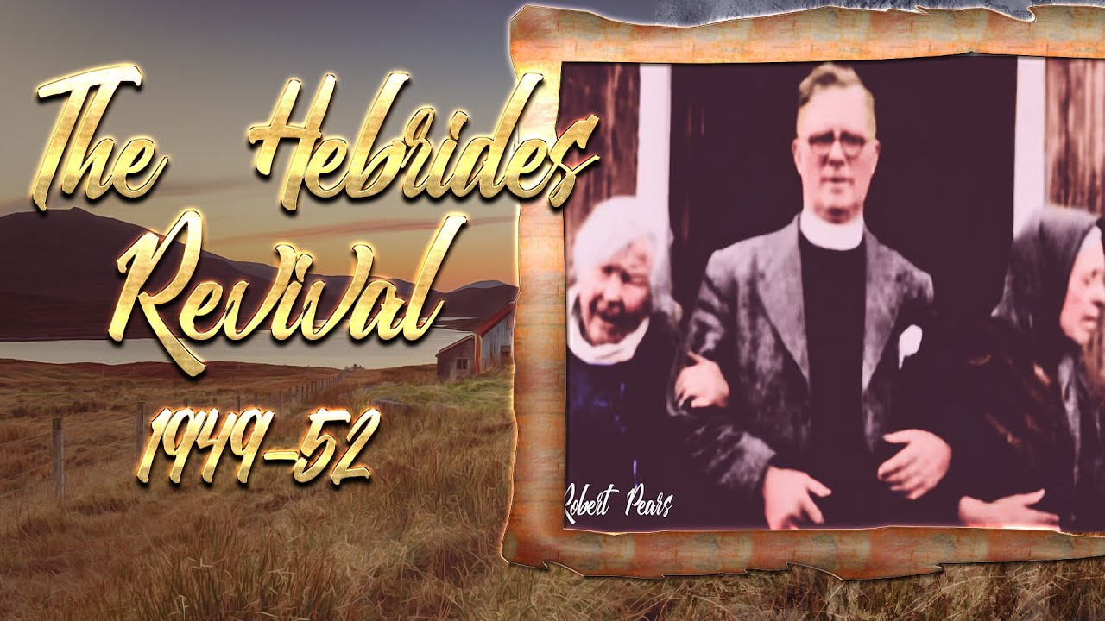
The Hebrides Revival of 1949

Slide 17
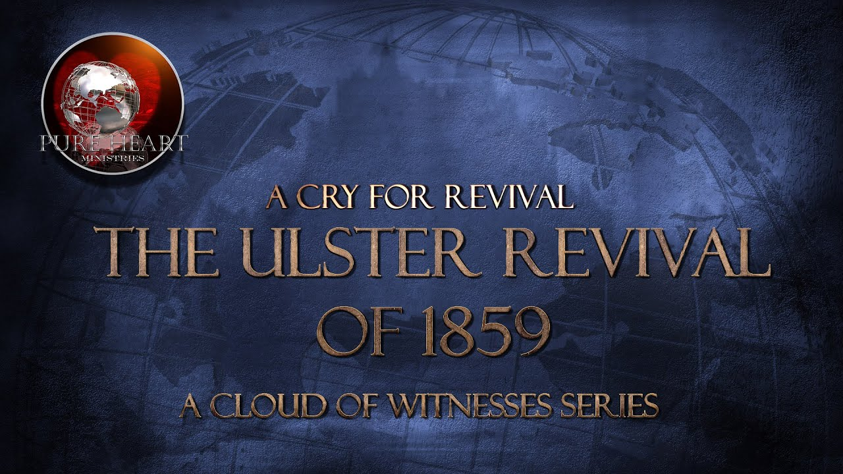
The Ulster Revival 1859

Slide 18
REVIVAL SONG 2
Revive Us Again

