Slide 1

Daniel Institute, MA Sacred Ministry
HISTORY OF
REVIVALS
By Charles Owiredu, PhD (Durham)

Slide 2


REVIVAL SONG 1
There’s A Sweet Spirit

Slide 3
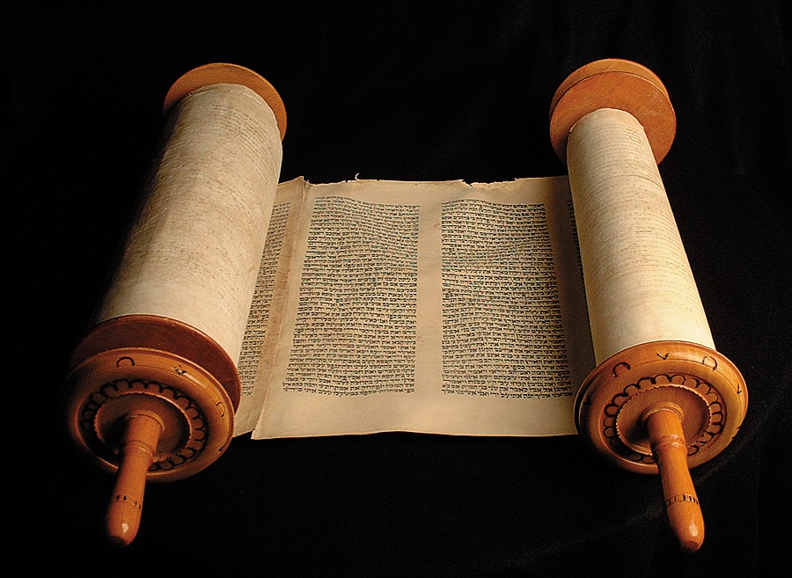
LECTURE
3
17th and 18th Century Revivals

Slide 4

17th and 18th Century Revivals
Seventeenth Century (17th)Revivals
Covenanters were members of a 17th-century Scottish religious and political movement, who supported a Presbyterian Church of Scotland and the primacy of its leaders in religious affairs. The name derived from Covenant, a biblical term for a bond or agreement with God.

Slide 5
17th and 18th Century Revivals
Seventeenth Century (17th) Revivals cont’d
Many Christian revivals drew inspiration from the work of early monks, from the Protestant Reformation and from the uncompromising stance of the Covenanters in 17th-century Scotland and Ulster, that came to Virginia and Pennsylvania with Presbyterians and other non-conformists. Its character formed part of the mental framework that led to the American War of Independence and the Civil War.

Slide 6
17th and 18th Century Revivals
Eighteenth Century (18th) Revivals cont’d
Britain
The Methodist revival of John Wesley, Charles Wesley and George Whitefield in England and Daniel Rowland, Howel Harris and William Willliams, Pantycelyn in Wales and the Great Awakening in America prior to the Revolution.
A similar (but smaller scale) revival in Scotland took place at Cambuslang.

Slide 7
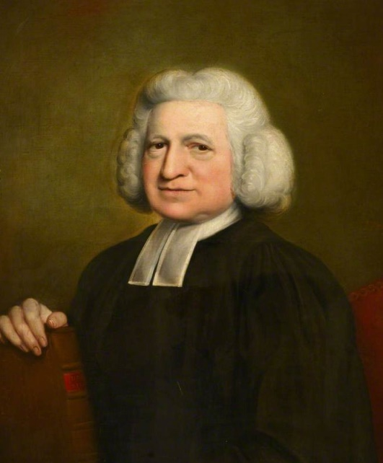
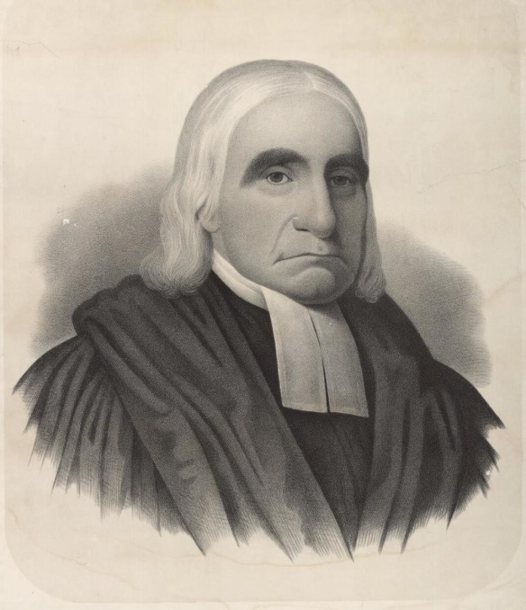
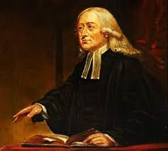
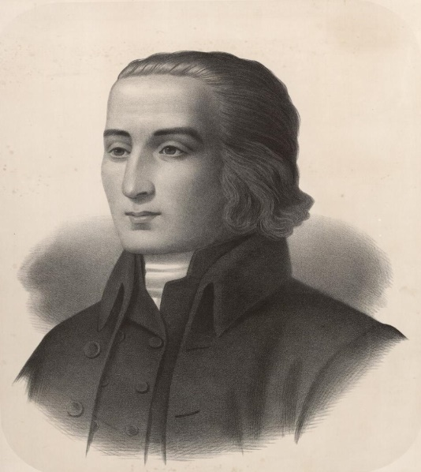
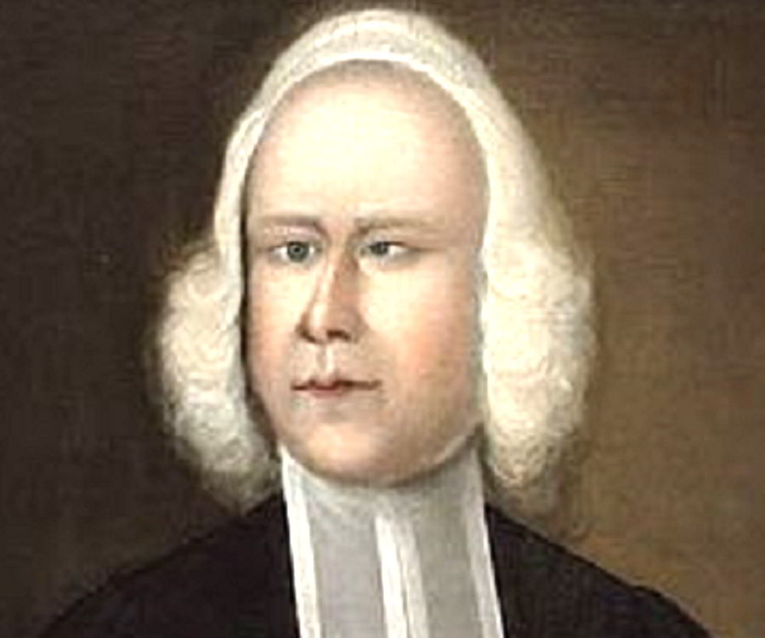
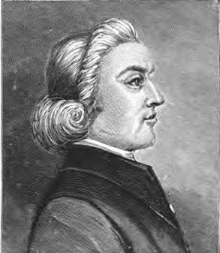
John Wesley
Charles Wesley
Daniel Rowland
George Whitefield
Howell Harris
William Williams

Slide 8
17th and 18th Century Revivals
American colonies
The First Great Awakening was a wave of religious enthusiasm among Protestants that swept the American colonies in the 1730s and 1740s.
This Awakening resulted from powerful preaching that deeply affected listeners (already church members) with a deep sense of personal guilt and salvation by Christ.

Slide 9
17th and 18th Century Revivals
American colonies
Pulling away from ancient ritual and ceremony, the Great Awakening made religion intensely emotive to the average person by creating a deep sense of spiritual guilt and redemption.
The Awakening brought Christianity to the slaves.

Slide 10
17th and 18th Century Revivals
American colonies
It incited rancor and division between the traditionalists who argued for ritual and doctrine and the revivalists who ignored or sometimes avidly contradicted doctrine, e.g. George Whitfield's being denied a pulpit in Anglican Churches after denying Anglican Doctrine.

Slide 11
17th and 18th Century Revivals
American colonies
Its democratic features had a major impact in shaping the Congregational, Presbyterian, Dutch Reformed, and German Reformed denominations, and strengthened the small Baptist and Methodist denominations.

Slide 12
17th and 18th Century Revivals
American colonies
It had little impact on Anglicans and Quakers.
The First Great Awakening focused on people who were already church members. It changed their rituals, their piety, and their self-awareness.

Slide 13
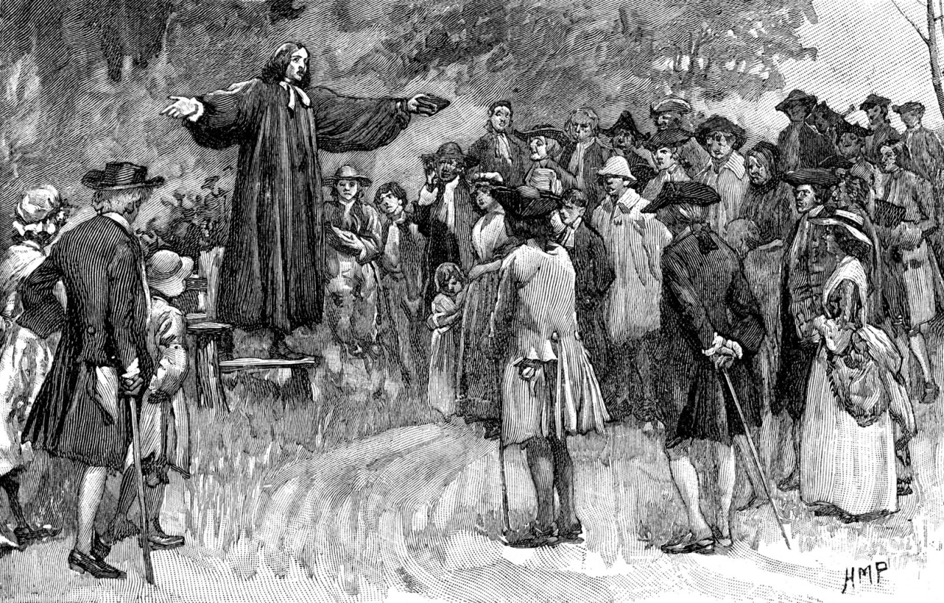
The Great Awakening

Slide 14
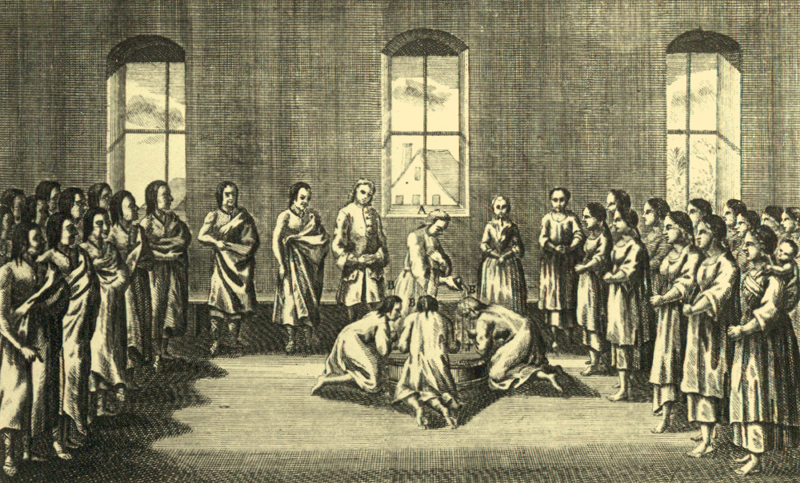
The Moravians Missionaries Prayer Warriors

Slide 15
REVIVAL SONG 2
Revive Us Again

