Slide 1

Daniel Institute, MA Sacred Ministry
HISTORY OF
REVIVALS
By Charles Owiredu, PhD (Durham)

Slide 2


REVIVAL SONG 1
There’s A Sweet Spirit

Slide 3
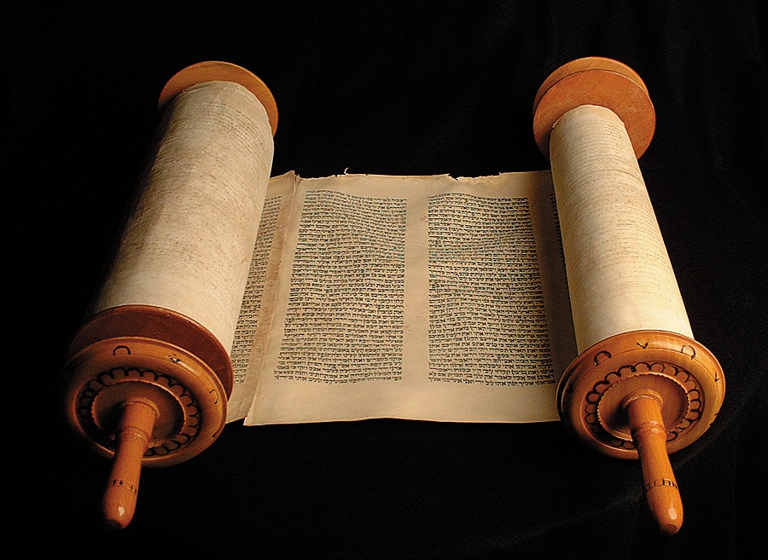
LECTURE
2
Renewals in the Old Testament and the New Testament

Slide 4

Renewals in the Old Testament and the New Testament
Within Christian studies the concept of revival is derived from biblical narratives of national decline and restoration during the history of the Israelites. In particular, narrative accounts of the Kingdoms of Israel and Judah emphasise periods of national decline and revival associated with the rule of various wicked or righteous kings, respectively. Josiah is notable within this biblical narrative as a figure who reinstituted temple worship of Yahweh while destroying pagan worship.

Slide 5
Renewals in the Old Testament and the New Testament
Renewals in the Old Testament
Examples of Revivals in the Old Testament (1000 year-period): There were revivals under:
Jacob in Gen 35:1-15
Moses in Exod 32:1-34:7
Samuel in 1 Sam 7:1-13
Sons of Korah in Ps 85:1-13
Elijah in 1 Kgs 18

Slide 6
Renewals in the Old Testament and the New Testament
Renewals in the Old Testament
Asa in 2 Chr 14-16
Jehoshaphat in 2 Chr 20
Hezekiah in 2 Chr 30:1-9
Josiah in 2 Chr 34:1-33
Zerubbabel in Haggai 1 and Zech 1:1-6, and
Ezra and Nehemiah in Nehemiah 8

Slide 7
Renewals in the Old Testament and the New Testament
Moses in Exod 32:1-34:7
l. He first interceded for the people when he was told they had fallen away from the Lord (Exod 32:11-13). Later he confessed the sin of the people (Exod 32:31-32). Still later he prayed again and asked to know the Lord and find favor with Him. He even requested that the Lord be present with His people (Exod 33:12-16). Moses' greatest concern though was that the Lord receive glory and so he prayed,
    If your Presence does not go with us, do not send up from here. How will anyone know that you are pleased with me and with your people unless you go with us? What else will distinguish me and your people from all the other people on the face of the earth?" (Exod. 33:15-16)

Slide 8
Renewals in the Old Testament and the New Testament
Moses in Exod 32:1-34:7
When Moses and the people all prayed at the tent of meeting. It is obvious that a revival occurred.
The clock ticked forwards some 400 hundred years to the time of the Judge and Prophet Samuel.

Slide 9
Renewals in the Old Testament and the New Testament
Samuel in 1 Sam 7:1-13
Samuel proclaimed revival to God’s people (1Sam 7:3).

Slide 10
Renewals in the Old Testament and the New Testament
Jerusalem Revival (Neh. 7:73-8:12) – About 440 B.C.
Ezra read the Torah – It was in the month Tishri (September-October), i.e. the 7th month of the Jewish calendar. He read from 6am to 12 noon in the hot sun of the Middle East. The people did not get tired; neither did they complain because it was a revival. They cried. They repented. They were forgiven and they rejoiced.

Slide 11
Renewals in the Old Testament and the New Testament
King Josiah’s paradigm (2Kin. 22)
The principles are:
A discovery of who we are.
Small group prayer
A commitment to Bible Study.
A commitment to pious living

Slide 12
Renewals in the Old Testament and the New Testament
Renewals in the New Testament
Examples of Revivals in the New Testament (100 year-period): There were revivals under:
John the Baptist (Matt 3:1-14)
Pentecost (Acts 2)
Revival can fade (Rev 2-3). When Christians lose their first love. See the Laodicean church.

Slide 13
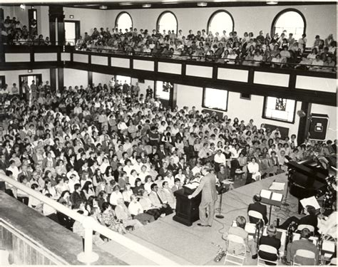
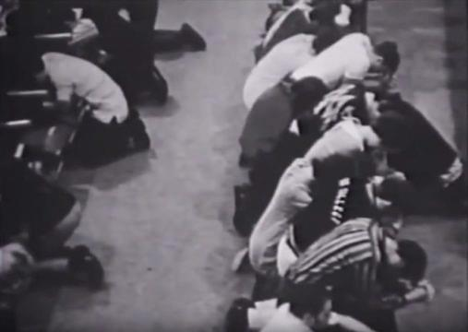
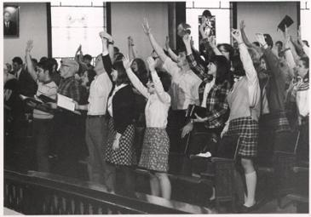
Images from the Asbury Revival

Slide 14


Slide 15
REVIVAL SONG 2
Revive Us Again

