Slide 1

Daniel Institute, MA Sacred Ministry
HISTORY OF
REVIVALS
By Charles Owiredu, PhD (Durham)

Slide 2


REVIVAL SONG 1
There’s A Sweet Spirit

Slide 3
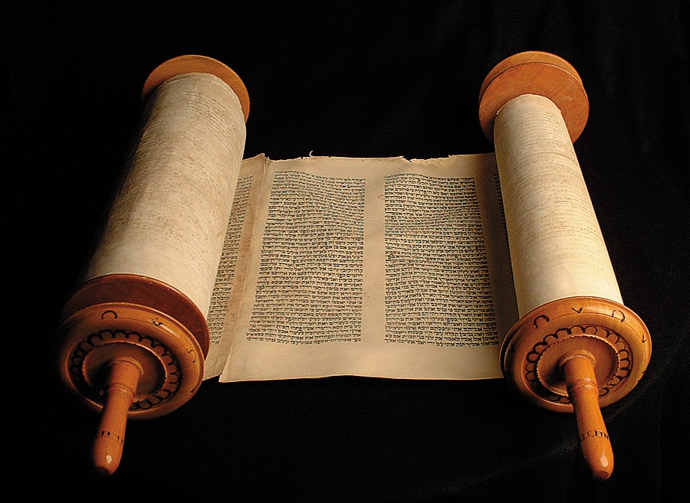
LECTURE
7
The Place of Prayer in Revivals

Slide 4
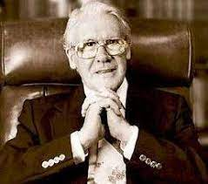
Leonard Ravenhill Quotes

Slide 5

“No man is greater than his prayer life. The pastor who is not praying is playing; the people who are not praying are straying. We have many organizers, but few agonizers; many players and payers, few pray-ers; many singers, few clingers; lots of pastors, few wrestlers; many fears, few tears; much fashion, little passion; many interferers, few intercessors; many writers, but few fighters. Failing here, we fail everywhere.”
― Leonard Ravenhill

Slide 6
“A man may study because his brain is hungry for knowledge, even Bible knowledge. But he prays because his soul is hungry for God.”
― Leonard Ravenhill

Slide 7
“Entertainment is the devil's substitute for joy. ”
― Leonard Ravenhill

Slide 8
“The greatest miracle that God can do today is to take an unholy man out of an unholy world and make him holy, then put him back into that unholy world and keep him holy in it.”
― Leonard Ravenhill

Slide 9
“How can you pull down strongholds of Satan if you don't even have the strength to turn off your TV?”
― Leonard Ravenhill

Slide 10
“The early church was married to poverty, prisons and persecutions. Today, the church is married to prosperity, personality, and popularity.”
― Leonard Ravenhill

Slide 11
“There are two kinds of people in the world—only two kinds. Not black or white, rich or poor, but those either dead in sin or dead to sin.”
― Leonard Ravenhill

Slide 12
“You can't live wrong and pray right.”
― Leonard Ravenhill

Slide 13
“When there’s something in the Bible that churches don’t like, they call it legalism.”
― Leonard Ravenhill

Slide 14
“Preacher, keep your knees on the ground & your eyes on the throne.”
― Leonard Ravenhill

Slide 15
“If we displease God, does it matter whom we please? If we please Him does it matter whom we displease?”
― Leonard Ravenhill, Why Revival Tarries: A Classic on Revival

Slide 16
“My goal is GOD HIMSELF. Not joy, not peace, not even blessing but HIMSELF...my GOD.”
― Leonard Ravenhill

Slide 17
“The Gospel is not an old, old story, freshly told. It is a fire in the Spirit, fed by the flame of Immortal Love; and woe unto us, if, through our negligence to stir up the Gift of God which is within us, that fire burns low.”
― Leonard Ravenhill, Why Revival Tarries

Slide 18
“There are three persons living in each of us: the one we think we are, the one other people think we are, and the one God knows we are.”
― Leonard Ravenhill, Why Revival Tarries

Slide 19
“The Church right now has more fashion than passion, is more pathetic than prophetic, is more superficial than supernatural.”
― Leonard Ravenhill, Revival God's Way

Slide 20
“If we had more sleepless nights in prayer, there would be fewer souls to have a sleepless eternal night in hell.”
― Leonard Ravenhill, Revival God's Way

Slide 21
“The apostles had no gold, but lots of glory. We have lots of gold, but no glory.”
― Leonard Ravenhill

Slide 22
“One of these days some simple soul will pick up the Book of God, read it, and believe it. Then the rest of us will be embarrassed. We have adopted the convenient theory that the Bible is a Book to be explained, whereas first and foremost it is a Book to be believed (and after that to be obeyed).”
― Leonard Ravenhill, Why Revival Tarries

Slide 23
“The opportunity of a lifetime needs to be seized during the lifetime of the opportunity.”
― Leonard Ravenhill

Slide 24
“Sodom, which had no Bible, no preachers, no tracts, no prayer meetings, no churches, perished. How then will America and England be spared from the wrath of the Almighty, think you? We have millions of Bibles, scores of thousands of churches, endless preachers—and yet what sin!”
― Leonard Ravenhill, Why Revival Tarries

Slide 25
“If we will do God’s work in God’s way at God’s time with God’s power, we shall have God’s blessing”
― Leonard Ravenhill, Why Revival Tarries

Slide 26
“The man who can get believers to praying would, under God, usher in the greatest revival that the world has ever known.”
― Leonard Ravenhill, Why Revival Tarries

Slide 27
“Yet ministers who do not spend two hours a day in prayer are not worth a dime a dozen, degrees or no degrees.”
― Leonard Ravenhill, Why Revival Tarries

Slide 28
“Today God is bypassing men—not because they are too ignorant, but because they are too self-sufficient. Brethren, our abilities are our handicaps, and our talents our stumbling blocks!”
― Leonard Ravenhill, Why Revival Tarries

Slide 29
“Notice, we never pray for folks we gossip about, and we never gossip about the folk for whom we pray! For prayer is a great deterrent.”
― Leonard Ravenhill

Slide 30
“The secret of praying is praying in secret.”
― Leonard Ravenhill Why Revival Tarries

Slide 31
“The tragedy of this late hour is that we have too many dead men in the pulpits giving out too many dead sermons to too many dead people.”
― Leonard Ravenhill, Why Revival Tarries

Slide 32
“Christianity today is so subnormal that if any Christian began to act like a normal New Testament Christian, he would be considered abnormal”― Leonard Ravenhill

Slide 33
“It has been well said that there are only three classes of people in the world today: those who are afraid, those who do not know enough to be afraid, and those who know their Bibles.”
― Leonard Ravenhill, Why Revival Tarries

Slide 34
“And before we can be clean and ready for Him to control, self-seeking, self-glory, self-interest, self-pity, self-righteousness, self-importance, self-promotion, self-satisfaction—and whatsoever else there be of self—must die.”
― Leonard Ravenhill, Why Revival Tarries

Slide 35
“Jesus said, ‘‘Go ye!’’ but He also said, ‘‘Tarry until!’’ Let any man shut himself up for a week with only bread and water, with no books except the Bible, with no visitor except the Holy Ghost, and I guarantee, my preacher brethren, that that man will either break up or break through and out. After that, like Paul, he will be known in hell!”
― Leonard Ravenhill, Why Revival Tarries

Slide 36
“God never intended His Church to be a refrigerator in which to preserve perishable piety. He intended it to be an incubator in which to hatch out converts. ― F. LINCICOME”
― Leonard Ravenhill, Why Revival Tarries

Slide 37
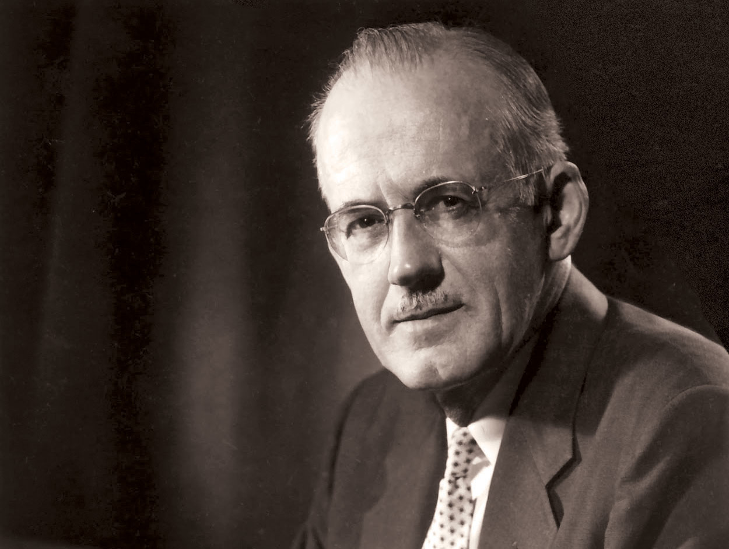
A. W. Tozer
Quotes

Slide 38

“God answers our prayers not because we are good, but because He is good.”
― A. W. Tozer

Slide 39
“[In our fast-paced life] we have no time for contemplation. We have no time to answer God when He calls.”
― A. W. Tozer

Slide 40
“Distractions must be conquered or they will conquer us. So let us cultivate simplicity.”
― A. W. Tozer

Slide 41
“I think that some of the greatest prayer is prayer where you don’t say one single word or ask for anything.”
― A. W. Tozer

Slide 42
“Prayer at its holiest moment is the entering into God [where] miracles seem tame … by comparison.”
― A. W. Tozer

Slide 43
“Prayer is always in danger of degenerating into a glorified gold rush. How to get things from God occupies most [books].”
― A. W. Tozer

Slide 44
“True prayer cannot be imitated nor can it be learned from someone else.”
― A. W. Tozer

Slide 45
“God’s loving motive is to bring us into total harmony with Himself so moral power & holy usefulness become ours.”
― A. W. Tozer

Slide 46
“Nothing is complete in itself but requires something outside itself in order to exist.”
― A. W. Tozer

Slide 47
“God formed us for His pleasure… He meant for us to see Him and live with Him and draw our life from His smile.”
― A. W. Tozer

Slide 48
“We please God most, not by frantically trying to make ourselves good, but by throwing ourselves into His arms.”
― A. W. Tozer

Slide 49
“God cannot be persuaded to alter His Word nor talked into answering selfish prayer.”
― A. W. Tozer

Slide 50
“Prayer will become effective when we stop using it as a substitute for obedience.”
― A. W. Tozer

Slide 51
“Wherever faith has eyes to see, there is a smiling presence of the Son of God.”
― A. W. Tozer

Slide 52
“You can see God from anywhere if your mind is set to love and obey Him.”
― A. W. Tozer

Slide 53
“The devil is a better theologian than any of us and is a devil still.”
― A. W. Tozer

Slide 54
“See to it that we pray more than we preach and we will never preach ourselves out.”
― A. W. Tozer

Slide 55
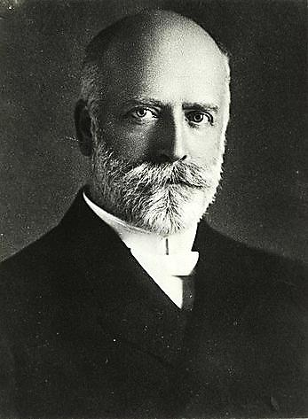
R. A. Torrey Quotes

Slide 56

“The reason why many fail in battle is because they wait until the hour of battle. The reason why others succeed is because they have gained their victory on their knees long before the battle came. Anticipate your battles; fight them on your knees before temptation comes, and you will always have victory.”― R. W. Torrey

Slide 57
“All that God is, and all that God has, is at the disposal of prayer. Prayer can do anything that God can do, and as God can do everything, prayer is omnipotent.”
― R. W. Torrey

Slide 58
“Prayer that is born of meditation upon the Word of God is the prayer that soars upward most easily to God's listening ears.”
― R. W. Torrey

Slide 59
“Those persons who know the deep peace of God, the unfathomable peace that passeth all understanding, are always men and women of much prayer.”
― R. W. Torrey

Slide 60
“When the devil sees a man or woman who really believes in prayer, who knows how to pray, and who really does pray, and, above all, when he sees a whole church on its face before God in prayer, he trembles as much as he ever did, for he knows that his day in that church or community is at an end.”
― R. W. Torrey

Slide 61
“We are too busy to pray, and so we are too busy to have power. We have a great deal of activity, but we accomplish little; many services but few conversions; much machinery but few results.”
― R. W. Torrey

Slide 62
“The chief purpose of prayer is that God may be glorified in the answer.”
― R. W. Torrey

Slide 63
“Many who read their Bibles make the great mistake of confining all their reading to certain portions of the Bible which they enjoy. In this way they get no knowledge of the Bible as a whole. They miss altogether many of the most important phases of Bible truth.”
― R. W. Torrey

Slide 64
“Triumphant prayer is almost impossible where there is neglect of the study of the Word of God.”
― R. W. Torrey

Slide 65
“Oh, men and women, pray through; pray through! Do not just begin to pray and pray a little while and throw up your hands and quit; but pray and pray and pray until God bends the heavens and comes down.”
― R. W. Torrey

Slide 66
“God's Word is pure and sure, in spite of the devil, in spite of your fear, in spite of everything.”
― R. W. Torrey

Slide 67
“To win men to acceptance of Jesus Christ as Saviour and Lord is the only reason Christians are left in this world.”
― R. W. Torrey

Slide 68
“Out of a very intimate acquaintance with D. L. Moody, I wish to testify that he was a far greater pray-er than he was preacher. Time and time again, he was confronted by obstacles that seemed insurmountable, but he always knew the way to overcome all difficulties. He knew the way to bring to pass anything that needed to be brought to pass. He knew and believed in the deepest depths of his soul that nothing was too hard for the Lord, and that prayer could do anything that God could do.”
― R. W. Torrey

Slide 69
“Do not study commentaries, lesson helps or other books about the Bible: study the Bible itself. Do not study about the Bible, study the Bible. The Bible is the Word of God, and only the Bible is the Word of God.”
― R. W. Torrey

