Slide 1

Daniel Institute, MA Sacred Ministry
HISTORY OF
REVIVALS
By Charles Owiredu, PhD (Durham)

Slide 2


REVIVAL SONG 1
There’s A Sweet Spirit

Slide 3
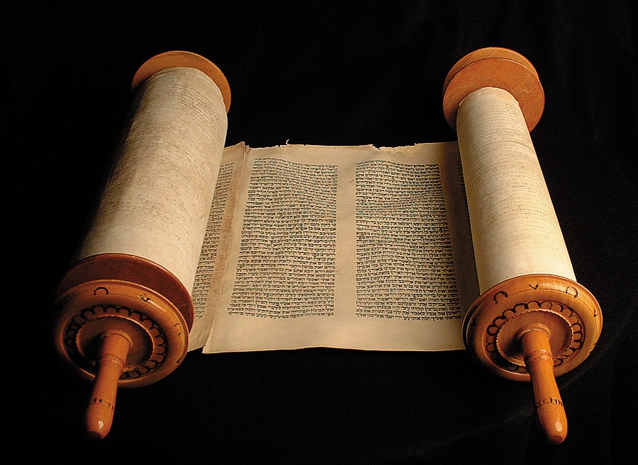
LECTURE
6
21st Century Revivals

Slide 4

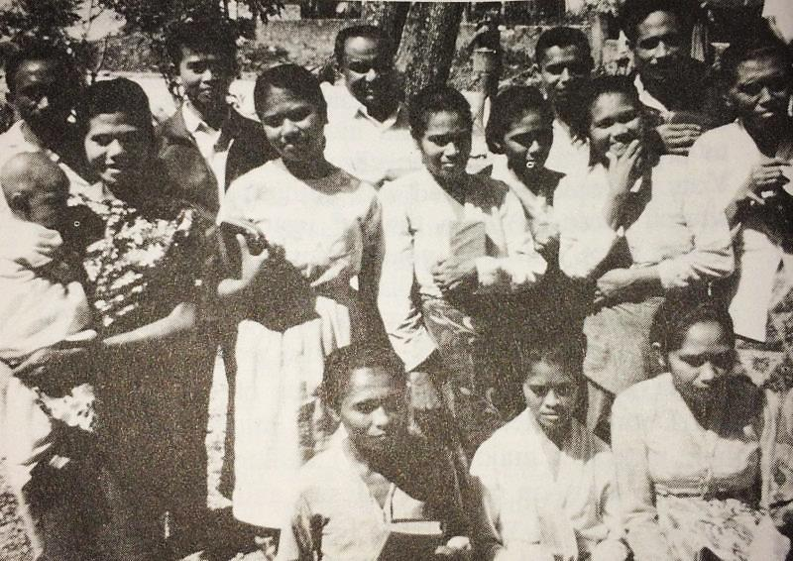
The 1965 Timor Revival

Slide 5
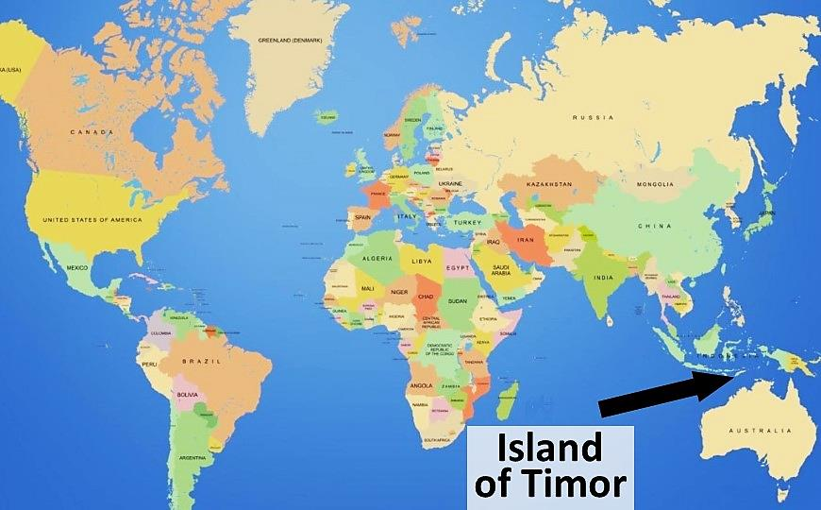
The western half of the Island of Timor is part of the Republic of Indonesia, the eastern half is the independent sovereign nation – the Democratic Republic of Timor-Leste.

Slide 6
21st Century Revivals
Introduction
The Timor Revival in Indonesia was a very controversial occurrence, as many of the reported miracles were too much for the western mind to accept. Among those who embraced theology leaning toward cessationism, this revival drew a tremendous amount of criticism.

Slide 7
21st Century Revivals
Introduction
In spite of the difficulty believing the reports, one of the most respected revival historians, the Baptist revivalist J. Edwin Orr, stated that
But questioning or discrediting of the more sensational reports has not invalidated the corroborated accounts of an unusual awakening on Timor.

Slide 8
21st Century Revivals
Conditions on Timor Prior to the Revival
Beginning in the 1600s the Dutch had colonized Indonesia. They had introduced Christianity, and the people were “Christianized” but never evangelized.
Before the revival came to Timor, “Christians” were still clinging to their occult practices. If a “Christian” possessed charms, amulets or fetishes, they would always return to them in their hour of need.

Slide 9
21st Century Revivals
Conditions on Timor Prior to the Revival
The former magic, sorcery, promiscuity, and alcohol use was common and acceptable, even for Christians.
Most of the Indonesian pastors saw no problem with their own or their congregation’s continual involvement with occult practices. Some pastors claimed that their powers of sorcery were God-given, having been handed down from their grandparents.

Slide 10
21st Century Revivals
Conditions on Timor Prior to the Revival
According to some estimates, 90 percent of the Christians routinely used the services of local shamans.
There was a huge shortage of trained ministers. One pastor had 48 congregations to care for
The island of Timor was ripe for a visitation from God!

Slide 11
21st Century Revivals
Events that Led to the Timor Revival
Summer of 1964: Johannes A. Ratuwalu, an Indonesian healing evangelist from the island of Rote, conducted highly successful ministry in the Timor city of Kupang. Among those healed were those blind, deaf, mute, lame, and mentally ill.

Slide 12
21st Century Revivals
Events that Led to the Timor Revival
Extraordinary Prayer: A man from the Maranatha Church in the city of Soe had a vision of the judgments of God, similar to the imagery found in The Book of Revelation. A woman in the same church had a vision of Jesus with the woman at the well (John 4), and this left her thirsting for more of God. Both visions led to a small group of people that started praying for revival.

Slide 13
21st Century Revivals
Events that Led to the Timor Revival
October 1964: Johannes A. Ratuwalu conducted a healing evangelistic campaign in the Timor city of Soe. Hundreds of people were healed and a greater hunger for a manifestation of the power of God was awakened among the people.

Slide 14
21st Century Revivals
Events that Led to the Timor Revival
January-February 1965: Pastor Binjamin Manuain (one of the two pastors at Maranatha Church in Soe) preached a series of evangelistic messages that was said to have awakened the congregation with a greater desire for revival.

Slide 15
21st Century Revivals
Events that Led to the Timor Revival
July 1965: Detmar Scheunemann, the German senior lecturer at the Indonesian Evangelistic Institute in the city of Batu on the island of Java, visited the island of Timor with a team of students from that school and conducted evangelistic campaigns in the Timor cities of Kupang, Soe, and other inland villages.

Slide 16
21st Century Revivals
Events that Led to the Timor Revival
August 16, 1965: A 25-year-old girl from the Maranatha Church in the city of Soe, Hennie Tunli’u, also known as Priscilla, after having received a dramatic calling into ministry through hearing the voice of God and having multiple visions of Jesus, began sharing with young people, and 87 of them became followers of Jesus.
Priscilla then felt led to attend the Indonesian Evangelistic Institute. Maranatha Church held a farewell service for her, and during the service Priscilla preached from 8 p.m. till 12:20 a.m. Her appeal to young people at the end of the service brought more than 100 to make a profession of their faith in Christ.

Slide 17
21st Century Revivals
Events that Led to the Timor Revival
On Sunday night, September 26, 1965
Two-hundred people gathered to pray in Maranatha Church. During the prayers, the Holy Spirit suddenly descended on the group just like upon the disciples on the day of Pentecost. Some reported that there was a sound like a tornado within the building (“a rushing mighty wind”).
During this outpouring of the Holy Spirit on the congregation, the presence of God was so powerful that many were weeping uncontrollably while lying on the floor.

Slide 18
21st Century Revivals
Events that Led to the Timor Revival
On Sunday night, September 26, 1965:
At the same time the officer at the police station close to the church sounded the fire alarm, as he saw that the church was on fire. The people in the community, who were the only functioning “fire department,” rushed to the scene to extinguish the fire. When they got to the church they saw the flames but saw no evidence of the church burning. They then recognized that it was the “fire of God.” (Fire on buildings was reported as having happened on several occasions.)

Slide 19
21st Century Revivals
Events that Led to the Timor Revival
On Sunday night, September 26, 1965:
Following this miraculous occurrence, the conviction power of the Holy Spirit became evident, and many of the thousand or so assembled outside the church to extinguish the fire received Jesus Christ as their Savior. After the Gospel was preached to them, they then ran to their homes, collected all their occult paraphernalia, returned to the church, and burned them in a fire.

Slide 20
21st Century Revivals
Events that Led to the Timor Revival
On Sunday night, September 26, 1965:
After Nahor Leo had shared his testimony on that evening, and after many people had made a decision to follow Jesus, Nahor chose 23 young people to join him on an evangelistic team. As they set out to preach all over the island, the Holy Spirit accompanied them with authority to preach the Gospel, with the power to heal, and with tremendous evangelical success.
After Nahor Leo’s team was assembled, many other teams also formed and began their evangelistic work throughout Timor and beyond.

Slide 21
21st Century Revivals
Events that Led to the Timor Revival
Early October 1965: A revival team from the Maranatha Church visited the town of Niki-Niki, and during a two-week evangelistic thrust, 9,000 people professed their faith in Jesus Christ.

Slide 22
21st Century Revivals
Events that Led to the Timor Revival
October 19, 1965:
In a letter on this date, Pastor J. M. E. Daniel (one of two pastors at Maranatha Church) wrote to the 35-year veteran Dutch missionary, Dr. Pieter Middlekoop, who had served on Timor for 35 years, and gave him a report of the revival.

Slide 23
21st Century Revivals
Events that Led to the Timor Revival
October 19, 1965:
Here are the highlights of that letter:
The revival was started by Hennie Tunli’u (Priscilla), and it affects mostly the youth.
Many of the youth have turned over their fetishes to be burned, along with their secret medicines, books with incantations and charms, and dice and objects for gambling.

Slide 24
21st Century Revivals
Events that Led to the Timor Revival
October 19, 1965:
Here are the highlights of that letter:
The youth arrange groups for prayer, scripture reading, and choir singing, specifically to prepare for evangelistic efforts.
The youth form teams and go out sharing the Gospel throughout the region and they are having great success in their work.

Slide 25
21st Century Revivals
Events that Led to the Timor Revival
October 19, 1965:
Here are the highlights of that letter:
Signs and wonders are taking place, with thousands being healed from various diseases.
Lives are being renewed.
Many people are converting to Christianity from paganism.

Slide 26
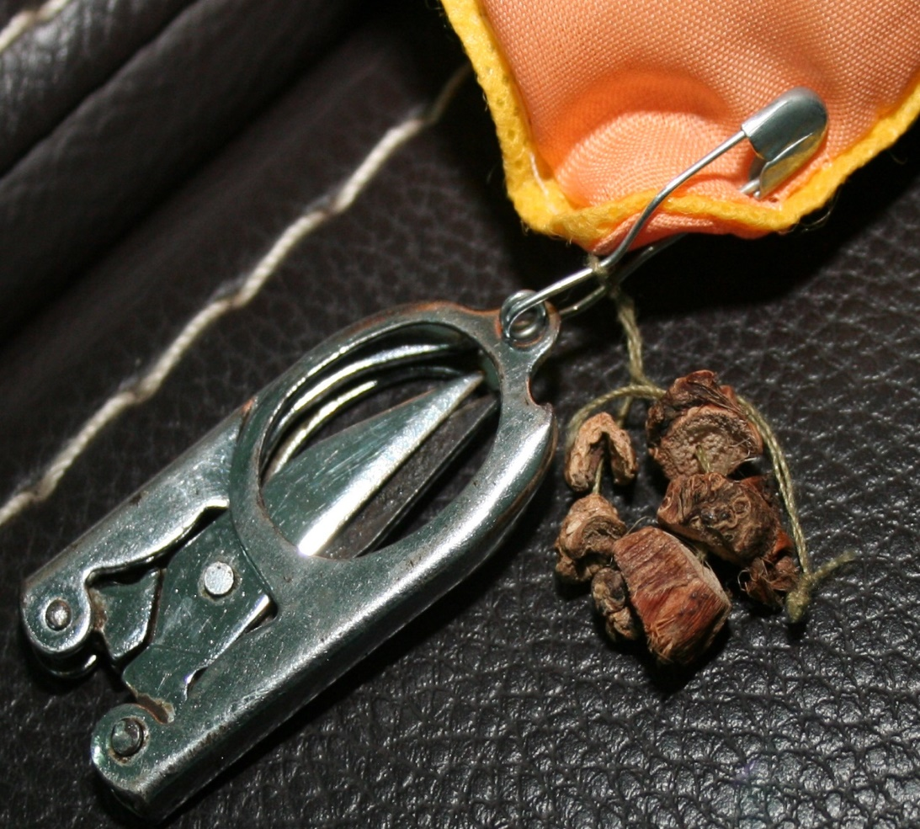
AMULET FASTENED TO A BABY’S PILLOW: August 11, 2013: During a young mother’s visit to the Swearingen’s Indonesian home, her baby was placed on our sofa, with its head resting on a pillow. The pillow had the above scissors and roots pinned to it. This amulet’s purpose was to scare away evil spirits.

Slide 27
21st Century Revivals
Unique Features of the Revival
Visions and Dreams
Many of those involved in the revival experienced visions and dreams. These served the purpose of calling people into ministry roles, as well as giving direction to ministry decisions.
Prophecies
Men and women alike during the revival had been given the gift of prophecy to recognize certain sins individuals were committing, and they used their discerning ability to call them out. Often this gift was used to tell people that they had occult objects hidden, and specifically where they had them hidden in their homes.
Some of the pastors opposed these young evangelistic team leaders because of their unique spiritual powers. They not only felt intimidated, seeing they did not possess similar powers, but they were also fearful that their own sins would be exposed.

Slide 28
21st Century Revivals
Unique Features of the Revival
Conviction of Sin
As is common in most all revivals, there was an overwhelming conviction of sin that accompanied the preaching of the Gospel.
Public Confession of Sin
Public confession of sins was made before the entire church, in small groups, and in private settings.
Team Ministry
Many evangelistic teams were formed following the pattern portrayed by Johannes A. Ratuwalu in 1964 and Detmar Scheunemann in 1965 during their evangelistic visits to the island of Timor.

Slide 29
21st Century Revivals
Miracles
Healings
Raised from the Dead
Amulets Embedded Under Skin Miraculously Come Out
Speaking in Unknown Languages
Calming of Storms
Supernatural Ability Given to Preach
Time Stood Still

Slide 30
21st Century Revivals
Miracles
Water Turned Into Wine
Clothes Miraculously Washed
Walking On Water
Miraculous Provision of Food
Supernatural Light Provided While Walking at Nights
Translation of Space
Divinely Given Songs
Blind People Received their Sight
Tens of Thousands Healed
A Shelter from the Heat of the Day

Slide 31
21st Century Revivals
Results of the Revival
►The revival in Maranatha Church spread to other churches.
►A new layman’s Bible institute was established in Soe beginning in 1967.
►A large core group of Christian workers in Maranatha Church became very supportive of the church’s ministries.
►From 1966-1967, the Maranatha Church’s membership increased by 1,000—reaching a membership of 4,000.
►The police reported that there was a dramatic change in social conditions, with harmony taking place in families and in the communities. Stolen goods were returned.

Slide 32
21st Century Revivals
Results of the Revival
►A lethargic atmosphere of the church was changed to a life filled with exuberance and a holy enthusiasm. The new life in the church was recognized in the fellowship, the singing, and in the public prayers.
►There was a renewed love for the Bible and the Lord.
►Many were sent out to start Christian schools in remote villages.
►Evangelistic teams were sent out from Timor to neighboring islands.
►Missionaries were sent to Japan, Thailand, Pakistan, Germany, and other locations.

Slide 33
21st Century Revivals
Results of the Revival
►Over 40 people from Maranatha Church alone went to the Indonesian Evangelistic Institute in the city of Batu to prepare for various types of ministry-related roles.
►There was a new openness in obedience to the leading of the Holy Spirit.
►The spiritual fruit remained. In 1972, a church in Kupang, which prior to the revival found it difficult to fill its building one time per week, began conducting three Sunday morning services. Many other churches in Kupang and other cities were also experiencing the same lingering effects from the revival.
►Kurt Koch, Mel Tari, and Don Crawford all affirm that 200,000 converts were won to the Lord between 1965 and 1970.

