Slide 1
The Jews and Judaism in the first Century Graeco-Roman World
Daniel Institute
BD IV 414 (Biblical Studies)
Dr Annang Asumang

Slide 2
Social, Cultural and Religious History
of first century Jews and Judaism during the Hellenic and Roman eras and the implications for interpretation of the New Testament

Slide 3
Learning Outcomes
Explain the relevance of the Hellenization and Romanization of Palestine by the Herodian dynasty for interpretation of the New Testament.
Explain the relevance of the varying responses of first century Jewish sects, namely, Pharisees, Sadducees, Herodians and the Scribes, to the presence of the Roman colonial rulers for interpreting the Gospels.
Assess the various ways in which the New Testament conceptually and successfully reimagined the temple institution.
Using appropriate examples, illustrate the different dynamics of the relationships between diaspora Jews and the Christian Churches in the cities of first century Graeco-Roman Empire.

Slide 4
Hellenization of Mediterranean World by Alexander the Great
Definition:
  Intentional or unstructured processes through which Greek civilization promoted itself and assimilated other nations in order to create a unified empire of common culture.
  Hellenism is evidence of process of Hellenization under way
Five Features of Hellenization or Hellenism
  Speaking of Greek (from minimal ability to full fluency) & adoption of Greek names
  Familiarity with Greek philosophy, education, literature and rhetoric
  Distinctively Greek architectural forms (i.e., stadiums, theatres, agora, gymnasia)
  Use of imported Greek tableware and cookware or their local imitations
  Civic planning and organization like a polis, with Grecan constitution, and officials
Different levels of Hellenization
  It tended to be more urban than rural even though it also served to unite the Greek Empire
  In Alexandria, Hellenization eventually resulted in the translation of the Hebrew Bible into Greek over one century starting roughly 270 BC which then mostly supplanted accessibility to the Hebrew text
  Aramaic remained predominant language of masses, but Greek became the official lingua franca, and certainly for commercial, legal and political discourse
  Jerusalem was transformed with Greek architecture and gymnasium built adjacent the temple (1 Macc. 1:14; 2 Macc. 4:9)
  In Galilee, evidence of Hellinization was late but demonstrated by completely Greek cities such as Sephorris, Tiberias

Slide 5
Two forms of Local Reactions to Hellenization
Enthusiastic Pragmatic Acceptance
  Those interested in upward social mobility adapted to Greek language and culture.
  Some took on Greek names and publicly projected Hellenistic patterns of behaviour
  High priest Jason for example attempted to “shift his compatriots to the Greek way of life.” (2 Macc. 4:10)
  It is claimed in 1 Macc that some Jews “removed the marks of circumcision,” so their lack of foreskins became less conspicuous as they exercised in the nude
Rejection & Resistance
  Especially rural folks became scandalized
  Increased emphasis on ritual purity among them
  Some moved into secluded communities that developed specialist eschatological ideas, e.g., Qumran community
  Others joined groups to actively oppose and seek to overthrow the colonialists and their “collaborators”

Slide 6
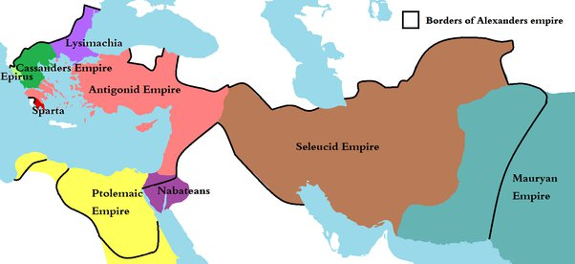
The Break-Up of Alexander the Great’s Empire
250yrs of
fight to
control
Palestine

Slide 7
Periods of Political history of Palestine
Ptolemaic Period (320-198 BC)
Seleucid Period (198-63 BC)
Hasmonaean (Maccabean) Period (140-37 BC)
Herodian Dynasty (37 BC – 73 AD)
Roman full Colonisation (63 BCff)

Slide 8
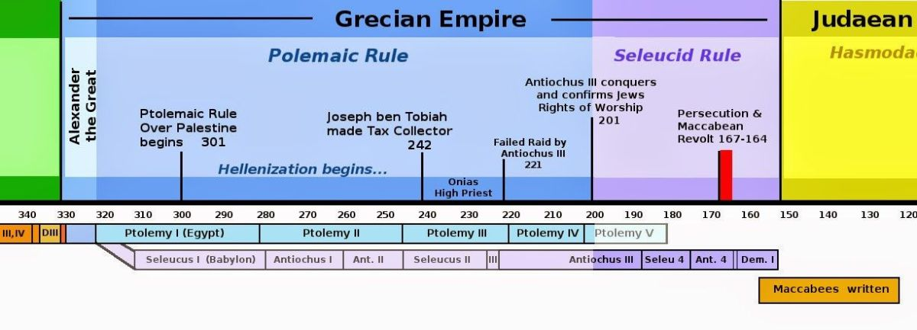

Slide 9
Palestine during the Ptolemaic Period
Despite their gruesome history, the Ptolemaic dynasty and their advancement was the most durable of the three successors of Alexander.
Their influence on Palestine was thus equally long standing even though this was largely through Hellenism rather than Egyptian culture.
In effect the Hellenization of Palestine in the two centuries before the Christian era was significantly through the medium of Alexandrian Ptolemies.
Politically the Ptolemies operated a clever hands-off administration of Palestine allowing for easier movement between Palestine and Egypt. For example, Yehud coins with Hellenistic Ptolemaic influences from the period have been found, indicating that Egypt remained the colonial power while Judea could mint low denomination coins for the local market.
Judea was controlled by the high priesthood, especially, Eleazer & Oniad II, as well as semi-autonomous administration of the region. Thus comparatively, the process of Hellenization of Ptolemaic Judea was slower than neighbouring provinces.

Slide 10
Escape of Jesus to Egypt: Matt 2:13-15
When they had gone, an angel of the Lord appeared to Joseph in a dream. ‘Get up,’ he said, ‘take the child and his mother and escape to Egypt. Stay there until I tell you, for Herod is going to search for the child to kill him.’ So, he got up, took the child and his mother during the night and left for Egypt, where he stayed until the death of Herod. And so was fulfilled what the Lord had said through the prophet: ‘Out of Egypt I called my son.’
Some scholars have wondered about the historical reliability of this episode especially given Matthew’s theological and typological interpretation of the sojourn in Egypt. However, given the background of Ptolemaic civilization, albeit two centuries earlier the link between Judea and Egypt is not implausible

Slide 11
Palestine during the Seleucid Period
Founded by the Macedonian Seleucus (305 – 281 BC); followed by successors one of which (Antiochus I) started the first war with the Ptolemaic Empire over Palestine, which the Seleucids named as Coele-Syria
Key Seleucid king from Judean perspective was Antiochus IV Epiphanes (215 – 164 BC).
  Aggressively Hellenized Palestine by introducing Greek cults and prohibiting native religious practices (1 Macc 1:41 – 50).
  Offered elite Jewish males Antiochian (Greek) citizenship
  Interfered with the customary hereditary appointment of Jewish high priest by appointing the Hellenophile Jason.
  Erected an altar to Zeus Olympios over the altar of burnt offering in the temple offering sacrifices on the 25th day of each month beginning with 25 Chislev 167 (1 Macc 1:41 – 61; 2 Macc 6:1 – 6).
  This sacrilege fulfilled prophecy of Dan 11:31 & 12:11, and Jesus referred to it as prototype oof the Antichrist (Matt 24:28)
  Ordered the destruction of Torah scrolls and forbade circumcision.
  Jerusalem was transformed into a Hellenistic city - state, complete with Greek gymnasium.
Antiochus’s over-zealous Hellenization led to the revolt that introduced the Hasmonean period.
  Judean elites during the period had become divided into those who were pro-Seleucid (e.g., Tobiad family) and those who were pro-Ptolemaic (Jason’s family). The seeds of Pharisee vs. Sadducees rivalry was sown through this divide
  Some pro-Seleucid priests such as Menelaus went to the extent of arguing that the idols introduced by the Seleucids were simply manifestations of Yahweh and thus rationalized their worship. The stage was set for the Hasmonean revolts

Slide 12
The Hasmonean (Maccabean) Period
The warring pro-Seleucid and pro-Ptolemaic priestly families ushered Judea into a period of chaos that was exploited further by the Seleucids, but this did not last
The inevitable revolt started when a priest from outside Judea, Mattathias with his three sons (one of whom was Judas Maccabeus) joined by the zealous Hasideans started guerilla warfare succeeded to drive out the Seleucids and restored the temple services in 164BC.
Jewish festival of Hanukkah (“dedication”) had its origin as a commemoration of this victory
After some setbacks when the Seleucids briefly returned the leadership returned to descendants of Mattathias that is, Hasmonean dynasty, named after Mattathias’s grandfather Hasmonean
Hasmonean dynasty ruled as both kings and high priests, marked by significant political and religious developments. They took on the trappings of the typical Hellenistic monarch
Despite starting as a revolution to overthrow Hellenism, the dynasty gradually reinstituted some of that cultures key features though religious sensitivities were now well preserved to avoid the overt offence caused by Antiochus
Ultimately, a civil war ensued between members of the Hasmonean aristocracy which invited the Romans to enter the fray from 63BC

Slide 13
Religious & Cultural Legacy of Maccabean Reign
Judas Maccabees saw and modelled himself as a new Gideon (Judges 6-8) and mixed his military strategizing with intense religious zeal that was to become typical of Jewish resistance of occupiers for the next three centuries
His success inspired a David vs Goliath holy war mentality which future Jewish revolutionaries and Messianic movements used as referent point in their battles against the colonizers
The consecration of the Jerusalem temple reignited a national vision of purity of Jewish worship in an aggressively polytheistic world and served as model for future ideas of revivals of Jewish religion. The focus of Herod to rebuild the temple in the next generation, though motivated by added political interest, was only possible because the Maccabees successfully restored the temple to its central place in Jewish religion
The celebration of Hannukah (Jn 10:22) which continues today is a lasting religious and cultural legacy. Its Messianic sub-text continues to inspire visions of deliverance from present enemies, albeit in less militaristic fashion
The emergence of the Pharisaic sect from the Hasidean section of the Hasmonean alliance laid the foundation for the future Christian religion, especially with its positive and negative influences on Paul

Slide 14
Herod the Great
After a period of instability, the Romans placed Judea under a new client king of Judea, Galilee & Perea by name of Herod, son of an Idumean convert to Judaism who had married into the Hasmonean family
Herod himself had received education in Rome, and with his father’s connections set about Romanizing Judea (introduction of Roman architecture, Roman coins, Roman art, and Roman inscriptions) on top of its Hellenization
  Erected fortresses
  Extensive building projects
  Rebuilt the second temple
  Theater, amphitheater, & a hippodrome,
  Temples to foreign deities, and a golden eagle above the gate to the temple
Erratic Romanesque dictatorship with surprising appointments and execution of those close to him, e.g., his wife & infanticide (Matt 2:16-23)

Slide 15
Herod the Great’s Main Construction Projects
Structures | Cities | In Diaspora
Rebuilding the temple | Caesarea Maritima complex | Antioch
Antonia Fortress | Sebaste (or Samaria) | Rhodes
Aqueducts and reservoirs | Alexandrium | Damascus
Machaerus (the Baptist imprisoned & killed here - Matt 14:6-10) | Masada
Herodium – palace fortress | Jericho

Slide 16
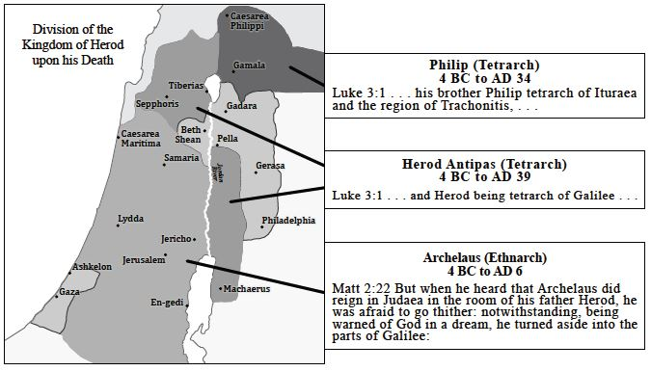
Palestine between the three
sons of Herod the Great

Slide 17
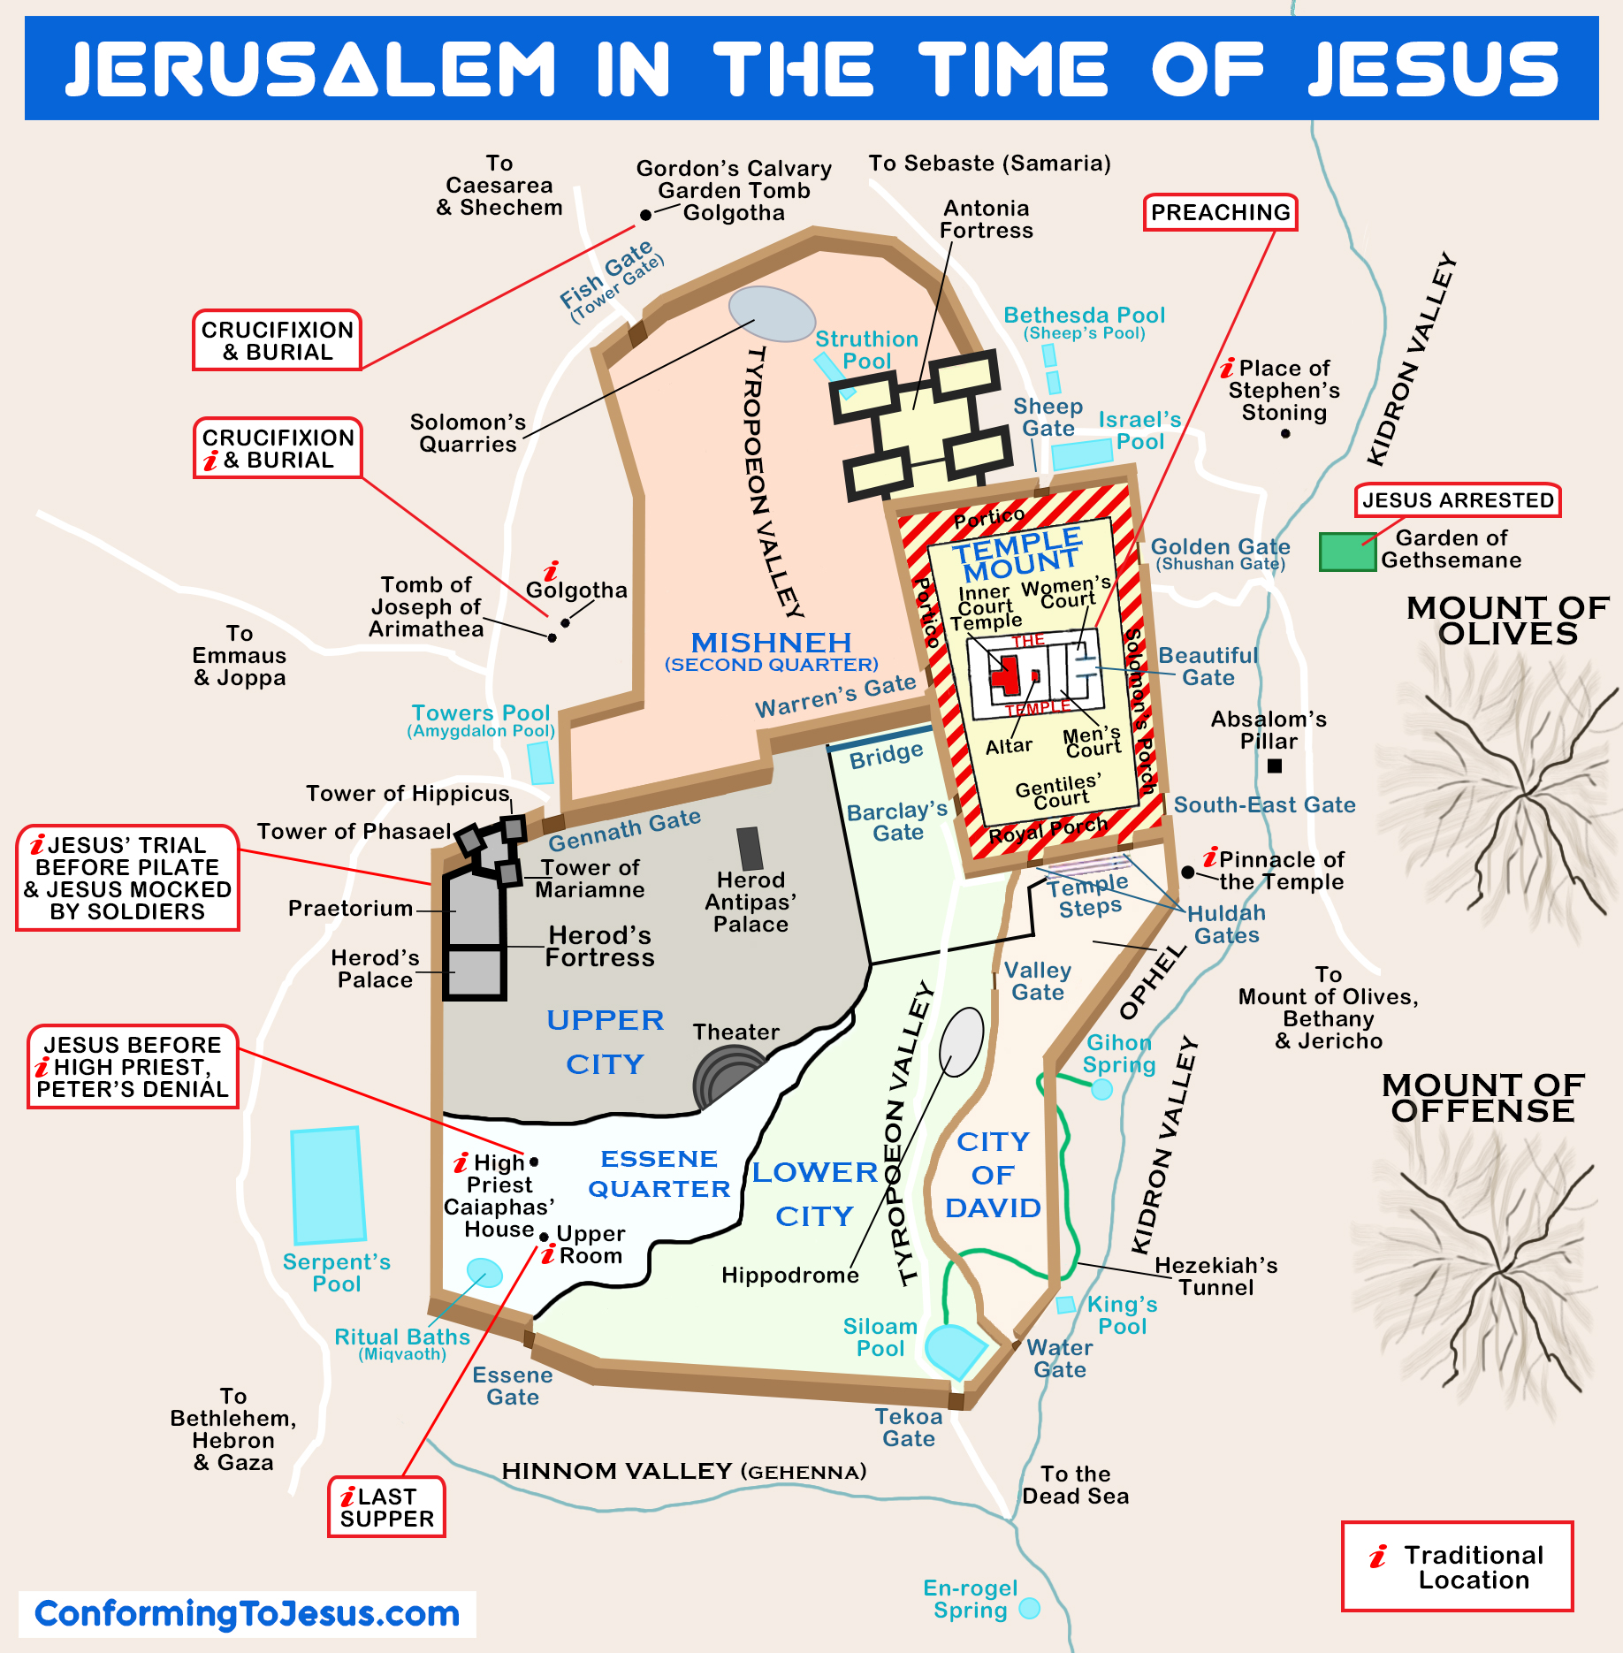
First Century Jerusalem
as a Hellenized &
Romanized City
Gymnasium
Antonia Fortress
Two Herodian palaces
The Praetorium
Hippodrome
Theatre
Water tunnels

Slide 18
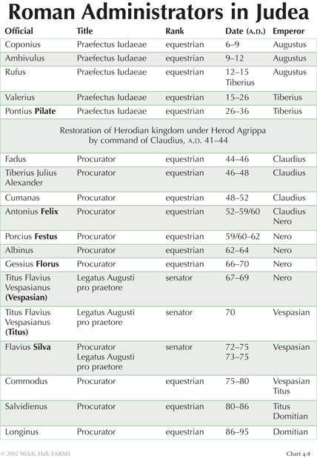

Slide 19
Hellenized, Hebraic & Gentile Christians in Jerusalem Church: Acts 6:1, 5, 8-9
In those days when the number of disciples was increasing, the Hellenistic Jews among them complained against the Hebraic Jews because their widows were being overlooked in the daily distribution of food…This proposal pleased the whole group. They chose Stephen, a man full of faith and of the Holy Spirit; also Philip, Procorus, Nicanor, Timon, Parmenas, and Nicolas from Antioch, a convert to Judaism…Now Stephen, a man full of God’s grace and power, performed great wonders and signs among the people. Opposition arose, however, from members of the Synagogue of the Freedmen (as it was called) – Jews of Cyrene and Alexandria as well as the provinces of Cilicia and Asia – who began to argue with Stephen.

Slide 20
The Church from its beginning was
a mixture of social classes, races,
ethnicities and immigration statuses.
The challenge was living together
in spiritual harmony.

Slide 21
Implications of Hellenization
Given the aggressive Hellenization and Romanization of Palestine any sharp distinction between “Palestinian (Hebraic) Judaism” and “Diaspora (Hellenistic) Judaism” as was commonly posited in scholarship prior to the 1990s is not only incorrect but leads into blind alleys of misinterpretations. Judaism was Hellenized everywhere in the Mediterranean world. Differences were due to matters of degree and diverse responses to it.
There were no doubt some linguistic, social class, and cultural differences and frictions between Jews who lived in Palestine and those who were either in the diaspora or as Acts 6 indicates, had returned from diaspora to the homeland. But these frictions reflected and support the flavour of variegation within the Judaism of the time rather than two distinctive Judaisms.
For this reason, the tendency also to posit that Christianity emerged from a so-called Hellenistic “branch” of Judaism is also wrong. The Hellenistic Jews who became Christians clearly had more educational and financial resources, as the case of Barnabas indicates. But they were not operating from a different “branch” of Judaism separate from the wrongly named “Jewish Christianity”. All of New Testament Christianity was Jewish and at the same time Hellenistic. As most scholars now agree, Jesus Himself must have spoken Greek alongside His Aramaic and Hebrew dialect

Slide 22
Second Temple Judaism
Second Temple Period (STP): historical era from the rebuilding of the second Jerusalem temple to the point of its destruction by the Romans, that is, from 539BC to 70AD.
Judaism during that period developed distinctive features: avid study of scripture, the observance of Jewish law, prayer as a mandated part of worship with the temple as focus, circumcision, key festivals and Sabbath rest.
However there were significant diversities of precisely how these tenets were applied leading to variegated subtypes of Judaism reflected in different literature produced by these communities
These subtypes were to a significant extent reflections of the varieties of responses, adaptations and conformities to the Babylonian & Persian influences of colonization, but even more especially the Hellenization and Romanization of its later centuries

Slide 23
Key Pillars of Second Temple Judaism
The Torah & its Study
The Covenant
  The Promised Land
  Circumcision
  Sabbath
  Ritual Purification
  Festivals
The Temple
  Animal Sacrifices
  House of Prayer
  Pilgrimages
  Recipient of Temple tax for its upkeep
Priestly Class & the Sanhedrin

Slide 24
The Temple Institution
Layout: Concentric rings of degrees of holiness
  Court of the Gentiles: outermost - with basilica-like colonnaded porch called the Royal Stoa or Solomon’s porch (Jn 10:23).
  Inner Court - Jews only. Paul falsely accused of bringing non-Jew here (Acts 21:27–32)
  Court of Women: serving as access to temple proper
  Court of Israelites: narrow court between the Court of the Women and altar for men
  Court only the priests and Levites could serve in the area around the altar
  Holy Place & Holy of Holies
Functions:
  Place of ritual sacrifices
  Repository of the Scriptures
  Treasury & economic hub
  Meeting place of the Sanhedrin

Slide 25
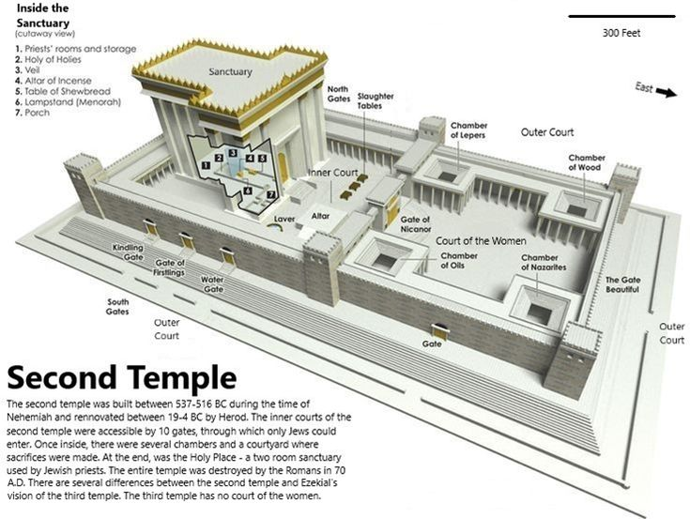

Slide 26
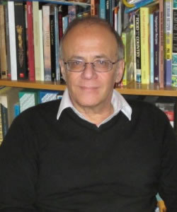
Richard Bauckham
Whether or not they could offer their own sacrifices by attending the temple, all Jews everywhere offered, in a sense, the daily burnt offerings every morning and evening, because these were paid for by the temple tax which all Jews paid and offered on behalf of Israel by the priests. The assiduity and enthusiasm with which Diaspora Jews paid their temple tax were not just because the temple tax was a symbolic expression of their allegiance to the religious centre of their nation; it was also actually the means by which the sacrifices offered in the temple enabled their own access to God. Also, of course, the ritual of the day of atonement effected atonement for all Jews without their having to be present. We should not underestimate the importance of the temple for Diaspora Jews even apart from pilgrimage to Jerusalem.
Richard Bauckham, The Jewish World around the New Testament: Collected Essays I, Jörg Frey (Ed.), WUNT 233 (Tübingen: Mohr Siebeck, 2008), 183–84.

Slide 27
The Temple & New Testament Christianity
Christological
  Jesus’ body replacing the temple (e.g., Matt 12:6; Jn 2:19-21)
Ecclesiological
  Church as the temple (e.g., 2 Cor 6:16; Eph 2:21; 1 Tim 3:14-16; Heb 10:21)
Eschatological
  New Jerusalem (e.g., Rev 21:22)
Anthropological
  Christian’s body as temple of the Spirit (e.g., 1 Cor 3:16-17; 6:19)
  Being living sacrifices (e.g., Rom 12:1-2)
Christian Devotion
  Paul (and other believers) as temple priests (e.g., Rom 15:16; Phil 2:17; 1 Pet 2:9-10)

Slide 28
The Jewish Sects
Pharisees
  Means "separated ones“
  Usually non-priestly though some priests and Levites joined (Acts 5:34), & some in Sanhedrin such as Nicodemus (Jn 3:1-10; 7:50; 19:39) and Gamaliel (Acts 5:34; 22:3)
  Notorious for ostentatious display of piety (Matt 23)
  Largely skeptical of Hellenization
  Theologically conservative
Sadducees
  Name related to Zadok meant “righteous ones”
  Elites and priestly aristocracy
  Enthusiasts of Hellenization with heavy influence by Epicurean philosophy
  Liberal theology denying resurrection (Mk 12:18-27; Lk 20:27) and spirits (Acts 23:8)
Essenes
  Derived from Jerusalem priests who broke away in protest of Hellenization to found their isolated community led by “Teacher of Righteousness”
  Dualistic theology with vibrant eschatology

Slide 29
More Jewish Sects
Herodians
  A largely political class in support of the Herodian dynasty championing Hellenization
  In Mk 3:6 they conspire with the Pharisees to kill Jesus
  In Mk 12:13-17 and Matt 22:16 they join some Pharisees to trap Jesus
  Identified in key moments of Gospel narrative Mk 6:21, 26; Matt 14:1-12; Lk 23:7-12
Scribes
  Technicians in producing legal documents, recording deeds, copying scriptures, and teaching
  Though not organized as group, were regarded as “experts” (Mk 2:16; Acts 4:5; 6:12; 23:9)
  Most are negatively portrayed, but a few appeared neutral to Jesus (Matt 13:52), or even praised by Him (Mk 12:28-34)
Zealots & Sicarii
  Avid revolutionaries who bitterly opposed Romanization with violence
  Some associated with Jesus & one Apostle was named Zealot (Lk 6:15 and Acts 1:13)
  Sicarii were an even more fearsome subgroup known for their terrorist activities

Slide 30
Formative Assessment Question
Explain the relevance of the varying responses of first century Jewish sects, namely, Pharisees, Sadducees, Herodians and the Scribes, to the presence of the Roman colonial rulers for interpreting the Gospels.

Slide 31
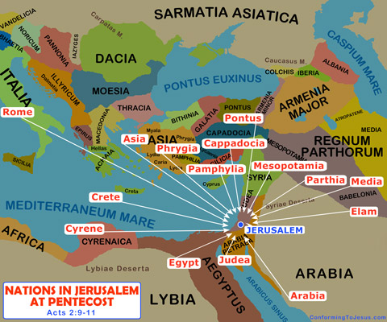
Jews in the Diaspora: Acts 2:5-11
“Now there were staying in Jerusalem God-fearing Jews from every nation under heaven…how is it that each of us hears them in our native language? Parthians, Medes and Elamites; residents of Mesopotamia, Judea and Cappadocia, Pontus and Asia, Phrygia and Pamphylia, Egypt and the parts of Libya near Cyrene; visitors from Rome (both Jews and converts to Judaism); Cretans and Arabs – we hear them declaring the wonders of God in our own tongues!’”

Slide 32
Jewish Diaspora Communities in other Locations
Josephus
  Nehardea & Nisibis (Josephus, Ant. 18.9.1 §§311-312),
  Seleucia (Josephus, Ant. 18.9.8-9 §§372-379),
  Antioch (Josephus, Ant. 12.3.1 §119),
  Lydia and Phrygia in Asia Minor (Josephus, Ant. 12.3.4 §§147-153)
Discovered Papyri
  Egypt, Teuchira, Apollonia, Ptolemais, & Latin-speaking North Africa
Philo, Legato 281-282
  Crete
Other Locations
  Kingdom of Bosporus (AD 41 inscription)
  Macedonia
  Greece
  Aetolia
  Attica
  Corinth
  The Peloponnese
  Euboea

Slide 33
Jews in the Graeco-Roman Diaspora
Forced Deportations after invasion
  Assyrian (Northern Israel) - 722 BC (2 Kgs 15-17)
  Babylonian (South Judea) - 581 BC (2 Kgs 23-25)
  Egyptian invasion & dispersion to Alexandria 322 BC
  Syrian invasion of Babylon and transporting Jews to Asia Minor 223 BC
  Internal displacement of some Judeans to Southern Galilee (e.g., Jesus’ family Lk 2:3-5)
  Roman I – 63BC
  Roman II – 70 AD
Voluntary Migration
  Especially to Egypt (e.g., Matt 2:13-15)
Philo (In Flaccum 43, 45) – 38 AD
  “Jews dwelling in Alexandria and Egypt from the Libyan slope to the borders of Ethiopia do not fall short of a million” and “no single country can contain the Jews because of their multitude”

Slide 34
Factors that determined how Jews coped with diaspora
Socio-Economic Factors
  Socio-Economic circumstances and opportunities in diaspora and its impact on choices the Jews might make
Socio-cultural Factors
  The nature of the social interactions with other cultural groups in diaspora and how they impacted the Jews
Political Factors
  The Graeco-Roman Empire’s political vision for conquered cultures which often fluctuated between Emperors
Theological Factors
  Jewish religious understanding and interpretation of their own diaspora existence and its impact on their responses

Slide 35
In Palestine, Hellenization and Romanization was often insidious and led to varieties of responses over centuries. In the diaspora, on the other hand, Hellenization and Romanization was much more advanced and inevitable even if in different variegated degrees due to the varieties of factors

Slide 36
Spectrum of Jewish Adjustments in Diaspora
Assimilation or Integration
  Abandonment of Jewish identity and adoption of the culture, customs, and values of the dominant or host culture
Adaptation
  Changes in certain aspects of the migrant culture imposed by the new social and cultural realities of the new environment without significant transformation of the core Jewish values and norms
Acculturation
  Exchange of cultural norms and patterns between the Jewish community and surrounding culture leading to transformation of both parties
Competition
  Social and cultural friction and competition with other immigrant or local cultural groups dominance
Isolation & Creolization
  Hedged isolationist community or at least resistive adaptation to protect tradition and avoid social and religious contamination

Slide 37
General Features of Jewish Presence in Diaspora
Generally lived in an organized politeuma which was officially recognized with respect to internal self-government. Most continued to pay the annual tax to the temple until its destruction when the money went to the Romans. Those who could afford returned to Jerusalem for major festivals (Acts 2), and others came for advanced studies
Many pagans regarded the Jewish God as inferior in their pantheon of gods as He seemed dedicated only to one tribe and was exclusionary. Their attitude therefore ranged from disdain, animosity and sheer dismissiveness.
Some Jews in response tended to show significant respect to the polytheistic and pagan environment so much so that even though they did not actively participate in them, they were comfortable enough to play public civic roles that demanded acquiescing to paganistic practices. Some Jewish communities were so “liberal” that a two-way traffic with pagan culture developed that allowed for Jews to compromise with pagan practices
These compromises enabled many Jews of the diaspora to comfortably serve as soldiers, land-owning farmers, agricultural labourers, shepherds, artisans, manual workers, traders, merchants, bankers, and government officials
Some pagans converted to Judaism, but others became “God-fearers” as they associated with the diaspora synagogue but also continued their devotion to other gods. Some of the centurions in the New Testament would have been like that.

Slide 38
Jewish Diaspora in Rome
Settlement dates back to 200BC topped up regularly by migrants and slaves from wars. Politically influential on events in Palestine evidenced by the network of Herodians with Roman elites and Senators. Many Jewish intellectuals came to Rome for advanced studies
Well-organized with established synagogues, religious schools, and other communal institutions to preserve their traditions and customs.
Pagan writers of the time complained about Jewish “separateness” (amixia), aloofness (akoinônêtoi), impiety for non-participation in imperial cult (aseibia) and hostility towards the local nations
Blamed for different reasons and frequently expelled from the city (e.g., Tiberius in 19 AD; Claudius 41 AD) for different reasons, sometimes for proselytism or intra-Jewish arguments
Christian presence must have been from earliest time of Jesus. Paul identifies several Jewish Christians in Rome (Rom 16). Certainly, topped by additions after Pentecost (Acts 2) and the great persecution (Acts 8:1). Later Paul and Peter imprisoned here.

Slide 39
Diaspora as a socio-theological concept
Primary meaning as “scattered” (Heb - tefutzah or nefutzah; Greek διασπορά) - scattering or dispersion of the Israelites among the nations
A subtype of exile in the sense that it was willed by God as punishment for national sin and with specific purpose, was temporary in the divine eschatological scheme and retained the Jews’ covenantal link to the land
Thus despite the negative circumstances of the diasporic existence, diaspora Jews derived powerful theological motivation in their existence as foreigners among the nation and spiritual incentive to remain true to their religion
This also meant that diaspora Jews maintain their socio-cultural distinctiveness among the nations and continued to look to the land as their inheritance, the torah as their “constitution” and the temple as the focus of their spirituality and piety
Starting with Jeremiah, prophets were inspired to write “Diaspora Letters”, instructing diaspora Jews on how to conduct themselves in their social situation.
This theological interpretation of diasporic existence was taken over by the Christians also, but without the land and temple (e.g., Acts 8:4; 11:19; 1 Pet 1:1; James 1:1)

Slide 40
1 Pet 1:1
Peter, an apostle of Jesus Christ: To God’s elect, exiles, scattered throughout the provinces of Pontus, Galatia, Cappadocia, Asia and Bithynia.
Παρεπιδήμοις (Resident Aliens)
It is possible that majority of recipients were Jewish immigrants in which case the term describes their social reality. But it is also possible that he is using it to describe their spiritual existence also as citizens of heaven living like exiles or resident aliens in a world that is not their own (cf. 1 Pet 2:11)
Διασπορᾶς (the Dispersion)
It is plausible that this describes their geographical reality as indeed the identified cities were spread over northern and middle Asia Minor. But it is more likely that he uses the term in a metaphorical and theological sense to represent the scattering of God’s chosen seed in the world to be means of broadcasting His salvation (cf. 2:9)

Slide 41
Christianity-Judaism dynamics in first century Smyrna (Rev 2:8-11)
To the angel of the church in Smyrna write: These are the words of him who is the First and the Last, who died and came to life again. ⁹ I know your afflictions and your poverty – yet you are rich! I know about the slander of those who say they are Jews and are not, but are a synagogue of Satan. ¹⁰ Do not be afraid of what you are about to suffer. I tell you, the devil will put some of you in prison to test you, and you will suffer persecution for ten days. Be faithful, even to the point of death, and I will give you life as your victor’s crown. ¹¹ Whoever has ears, let them hear what the Spirit says to the churches. The one who is victorious will not be hurt at all by the second death.
The powerful Diaspora Synagogue of Smyrna employed
all the political powers at its disposal in bitterly persecuting the
earliest Christians in the city as they perceived them as
undermining their hard-won autonomy in the city.

Slide 42
Impact of Introduction of Christianity into Jewish Diaspora
Complicated and Impacted by Local politics
  As most early Christians were Jews, and as some Gentiles in any case joined Synagogues, the first Christians in the early phases were regarded and behaved basically as a section of Judaism in diaspora
  Depending on local Synagogue leanings the relationship with Christians varied from toleration to hostility
  Outsiders also initially treated the two as the same until key sticking points later emerged
  Later, Jews with political clout persecuted Christians as the later were calling undue attention from pagans
Radical Differences in Theology
  Christology played as much a role as nature of Christian practices as trigger of friction
  Christian vision of believers’ relation with Yahweh was radically different from what some diaspora Jews had accommodated themselves to. For example, refusal to eat idol food may have appeared an extreme demand for some assimilated Jews
  Abandonment of demand for circumcision of Jews blunted the edges of the difficulties that some pagans had in their interactions with diaspora synagogues but upset Jews
Christian Evangelism As Major Trigger
  Christian evangelization set them apart from diaspora Judaism and indeed became a major source of fissure.
  Punishment of whipping meted out to the Roman citizen Paul by the Jews in 2 Cor 11:24 was for his evangelism, not necessarily the content of his teaching.
  The friction between Christians and the synagogues was on two levels, namely, (a) their evangelistic fervour in including Gentiles without Judaizing them, and (b) the content of the evangelion they preached

Slide 43
Questions?

